Slide 1
Notes:
Welcome to the Pacific Adventures of the Climate Crab!

Slide 2
Weather and climate
Climate variability and climate change
Different time scales and forecasts
Early warning, early action
The Pacific region’s changing climate
Future climate of the Pacific
For more information

Slide 3
Weather describes the current atmospheric conditions, e.g. rainfall, temperature or wind speed at a particular place and time
Climate is the average pattern of weather for a particular place over a long period of time (e.g. 30 years)
‘Climate is what we expect. Weather is what we get!’
Notes:
Weather refers to atmospheric conditions such as temperature and rainfall over a short period of time – a few hours or a few days. Weather changes from day to day and the changes are easy to see. Climate, on the other hand, is the average pattern of weather for a particular place measured over a long period of time, usually at least 30 years. Changes in climate are not easy to detect, they require careful measurement with special instruments over long periods of time. One easy way to remember the difference between climate and weather is by using the phrase ‘Climate is what we expect. Weather is what we get!’

Slide 4
Climate variability is monthly, yearly and decadal variability due to natural processes and feedbacks. The main driver of climate variability in the Pacific region is the El Niño Southern Oscillation (ENSO)
Climate change is a long-term shift or trend in climate conditions (e.g. global warming) and can produce shifts in averages, extremes and variability of temperature, rainfall, sea level and other variables.
Climate variability and climate change can occur independently, but also at the same time.
Notes:
Climate variability is variability that is due to natural processes and feedbacks and can occur on monthly, yearly and decadal timeframes. There are many features of the climate in the Pacific that influence this variability, including cloud meeting places like the South Pacific Convergence Zone, the Intertropical Convergence Zone and the West Pacific Monsoon. The main driver of climate variability in the Pacific region is the El Niño Southern Oscillation (ENSO) or the swing between El Niño, La Niña and neutral conditions.
Climate change is a long-term shift or trend in climate conditions (e.g. global warming) and can produce shifts in averages, extremes and variability of temperature, rainfall, sea level and other variables. Climate variability and climate change can occur independently, but also at the same time – so while the climate is getting warmer there will still be variability in temperature with cool days and warm days – it’s the average climate that is getting warmer.

Slide 5
Climate change
Climate variability
Weather
hours
days
months
years
decades
centuries
Rain storm
Wet season &
dry season
Tropical cyclone
El Niño and La Niña
Global warming
&
ocean acidification
Notes:
One way to understand the difference between weather, climate variability and climate change is to think about how they operate on different time scales.
The big arrow refers to different periods of time – days, months, years, decades and centuries. We can see here that weather refers to hours, days and maybe months; climate refers to months, years and decades and climate change refers to decades and centuries. Examples of weather are rain storms that might last one or two hours and tropical cyclones that may last days. Climate variability can be defined by climate patterns such as the El Niño and La Niña and climate change refers to things which happen over centuries, like global warming.

Slide 6
Forecasts can be available hours, days, weeks, months, or even decades in advance.
For example, the Vanuatu Meteorology and Geo-hazard Department could release a severe weather warning for the next 24 hours, forecasting winds of 40 to 50km an hour and very heavy rainfall with a chance of flooding in some areas, or they could issue a seasonal forecast, predicting a strong El Niño in the Pacific and forecasting below average rainfall in Vanuatu over the coming three months.
Notes:
Forecasts can be available hours, days, weeks, months, or even decades in advance. For example, the Vanuatu Meteorology and Geo-hazard Department could release a severe weather warning for the next 24 hours, forecasting winds of 40 to 50km an hour and very heavy rainfall with a chance of flooding in some areas or they could issue a seasonal forecast, predicting a strong El Niño in the Pacific and forecasting below average rainfall in Vanuatu over the coming three months.

Slide 7
more specific information
Climate change
rising risks, trends, more surprises
Decades, end of century
Longer
lead time
Seasonal forecasts
level of risk in coming months
next 3-6 months
Weather forecasts
impending hazard
10 days or less
Shorter
lead time
more time to reduce risk
Notes:
Climate and weather information is an important tool that we can use when taking action to prepare for extreme events. We can use information and forecasts across different time scales. Longer lead-time forecasts can only tell you if there is an increased risk, but at the same time, they give you much more time to prepare and reduce risk. Shorter lead-time forecasts can give you more specifics in terms of where and when an extreme might occur, but you will have much less time to prepare and reduce risk. Different actions may be more appropriate for different time scales.

Slide 8
Climate and weather information can help us anticipate and prepare for changing risks.
Early warning, early action is about making use of climate and weather information before a disaster or extreme event strikes and acting sooner than you would do without this information
Notes:
We can use climate and weather information to help us anticipate and prepare for changing risks due to extreme events or disasters.
Early warning, early action is about taking smart action and making use of climate and weather information before a disaster or extreme event strikes. Early warning early action is about acting sooner than you would if you didn’t have this information. It is important to understand what is happening to the climate around you and what is likely to happen in the future.

Slide 9
While there is considerable variation from country to country, the climate has changed across the Pacific region
Temperature
There is warming at all locations in the Pacific
Rainfall
Rainfall across the region has increased and decreased in response to natural climate variability, such as opposite rainfall variations to the north-east and south-west of the South Pacific Convergence Zone due to natural decadal climate variability.
Oceans
Sea level has risen (regional distribution)
Ocean acidification has increased
Notes:
The climate has an impact on all of our lives in the Pacific and our climate is changing. Scientists have been measuring the ways that the climate has changed across the Pacific. While there is considerable variation from country to country, there are some general similarities in the changes taking place across the region. Temperature has warmed at all locations in the Pacific with Pacific island annual temperature trends ranging between 0.1 to 0.2 °C per decade between 1960 and 2009. Rainfall across the region has increased and decreased in response to natural climate variability, such as opposite rainfall variations to the north-east and south-west of the South Pacific Convergence Zone due to natural decadal climate variability. There have been big changes to our oceans too. Sea level has risen, however there are differences across the region. Ocean acidification has increased across the Pacific, Ocean acidification happens as the ocean absorbs more and more carbon dioxide. As our seas become more acidic, our coral reef ecosystems are threatened.

Slide 10
Increases in air temperature
Increases in extreme rainfall
Increases in extreme temperature events
Increases in sea-surface temperature and sea level rise
Changes in rainfall, tropical cyclones and wind speed
Increased ocean acidification
Notes:
Future changes in our region’s climate will have big impacts on all of our lives. Understanding the possible future climate of countries in the Pacific region is important so communities, organisations, government and businesses can all plan for change. Scientists have come up with the following ‘projections’ for the Pacific’s future climate. It is important to recognise that the Pacific is a very large region, and there will be a variety of different conditions and impacts depending on which country you are in. But broadly speaking, temperatures will continue to increase and there is likely to be increases in extreme rainfall and extreme temperature events. The sea surface temperature will increase and sea levels will continue to rise. Our rainfall patterns will change and this will have different impacts on different parts of the region. There will also be changes to tropical cyclone occurrences and wind speeds. Our coral reef ecosystems will be under increased threat as our oceans become more and more acidic.

Slide 11
For more detailed information on the changes in the current and future climate of your country, visit www.pacificclimatechangescience.org or contact your local weather office.
Notes:
For more detailed information on the changes in the current and future climate of your country, visit www.pacificclimatechangescience.org or contact your local weather office.

Slide 12
The Pacific Adventures of the Climate Crab is a collaboration between Red Cross and the Australian Government’s Pacific-Australia Climate Change Science and Adaptation Planning (PACCSAP) Program. The project is being implemented by the Red Cross, the Australian Bureau of Meteorology, the Commonwealth Scientific and Industrial Research Organisation (CSIRO), the Vanuatu Meteorology and Geo-hazard Department (VMGD) and the SPC-GIZ Climate Change Program.

Slide 15
Seasonal forecast scenarios
Scenario 1: Above average rainfall
There is a La Niña in the Pacific. The Solomon Islands Meteorological Service forecasts above average rainfall for the coming three months in the Solomon Islands. High rainfall and floods may be possible.
Scenario 2: Below average rainfall
There is an El Niño in the Pacific. Below average rainfall is forecast for the coming three months in Tonga. The Tonga Meteorological Service releases a drought warning stating that some areas may experience water shortages. They advise people to take measures to minimise the impact of drought.

Slide 16
Scenario 3: Below average rainfall
There is a La Niña in the Pacific. Below average rainfall is forecast for the coming three months in Kiribati. The Kiribati Meteorological Service releases a drought warning stating that some areas may experience water shortages. They advise people to take measures to minimise the impact of drought.
Scenario 4: Cyclone season
It is the beginning of the rainy season in Vanuatu. The Vanuatu Meteorology and Geo-hazard Department releases the tropical cyclone outlook for the season. There are 9 – 12 tropical cyclones forecast for the Pacific region and Vanuatu is likely to experience close to normal or slightly above normal tropical cyclone activity. The Vanuatu Meteorology and Geo-hazard Department forecasts that 2 – 4 cyclones may affect the country and asks the people of Vanuatu to remain vigilant at all times during this cyclone season.

Slide 17
Weather forecast scenarios
Scenario 5: Severe weather warning
It is the middle of the rainy season in Samoa. The Samoa Meteorology Division releases a severe weather warning. Winds of 60 km/hour are expected in the next 24 hours and heavy rain is forecast for much of the country. A flood and landslide advisory for vulnerable areas is also in effect. High seas and marine wind warnings are also in place.
Scenario 6: Tropical cyclone warning
It is cyclone season and a Category 4 cyclone is approaching Fiji from the northeast. The Fiji Meteorological Service releases an updated warning on Tropical Cyclone Iris. Very destructive hurricane force winds with average speeds to 180 km/hr and momentary gusts to 240 km/hr are expected in the next 24 hours. Heavy rain and flooding of low-lying areas is also expected. A damaging heavy swell warning is in place for all Fijian waters. The next warning on Severe Tropical Cyclone Iris will be issued at 6:00pm.

Slide 18
1. Impacts
Can you remember a time that this has happened before?
What impacts could this scenario have on your community, organisation, sector, country or region (facilitator to choose which is more appropriate for the audience)?
2. Information
Where can you get warnings and more information about this scenario?

Slide 19
3. Solutions
Think about existing responses to these impacts. What works well that can be done more? What can be done differently or better next time?
What no cost or low cost actions can be taken in the near future to prepare for this scenario?
How would you make sure these actions are implemented into the future (not once-off)?
Which stakeholders could you pro-actively communicate and work together with?
Be as specific or general as you like (for example, you could think about community responses, or sector-based, national, organisational or regional responses).

Slide 20
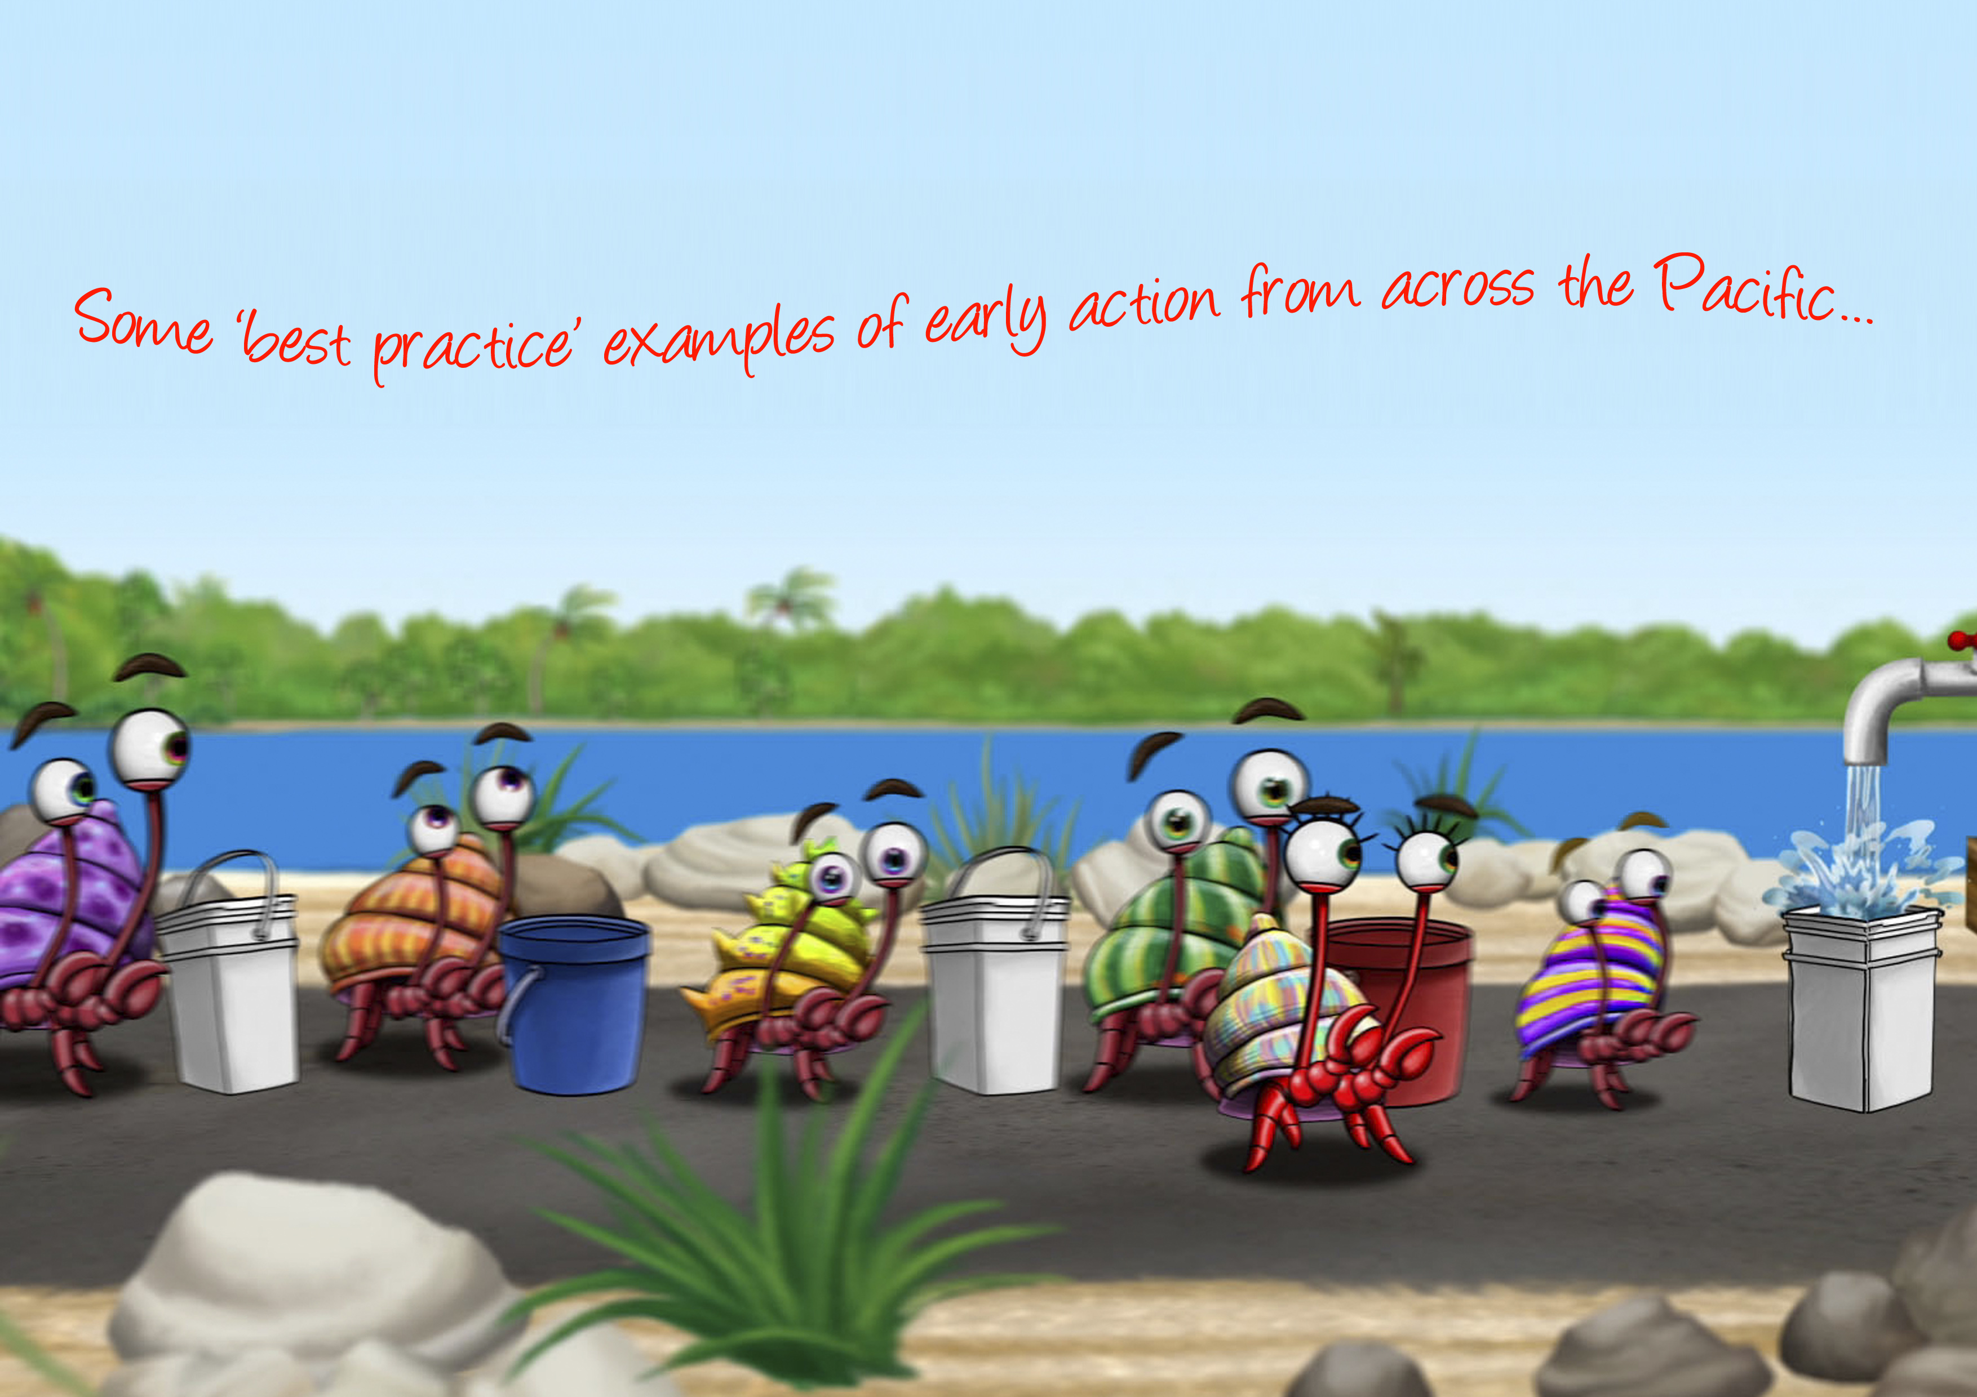

Slide 21
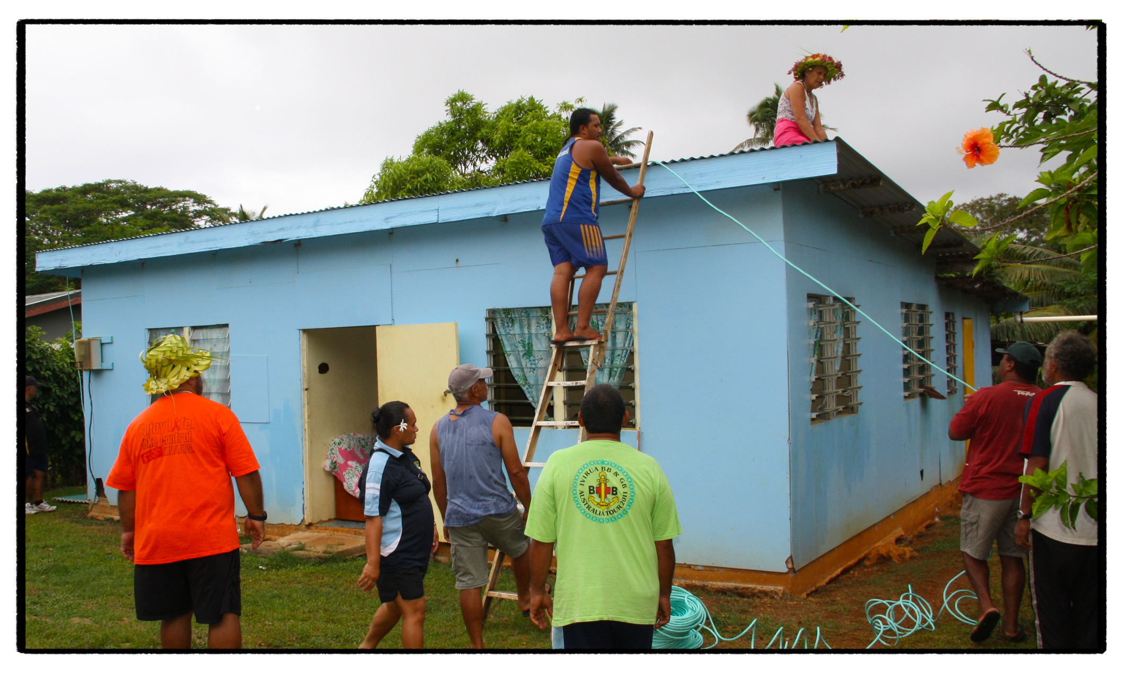
Cyclone season preparedness. Mangaia, Cook Islands. Image: Red Cross 2012
Notes:
The Red Cross Mangaia Island branch, in the southernmost part of the Cook Islands, has been supporting community preparedness for the cyclone season. This has included mobilising volunteers to tie down roofs of houses and assisting in the interpretation of cyclone early warnings. Cook Islands Red Cross undertakes these activities in conjunction with local government and island chiefs.

Slide 22
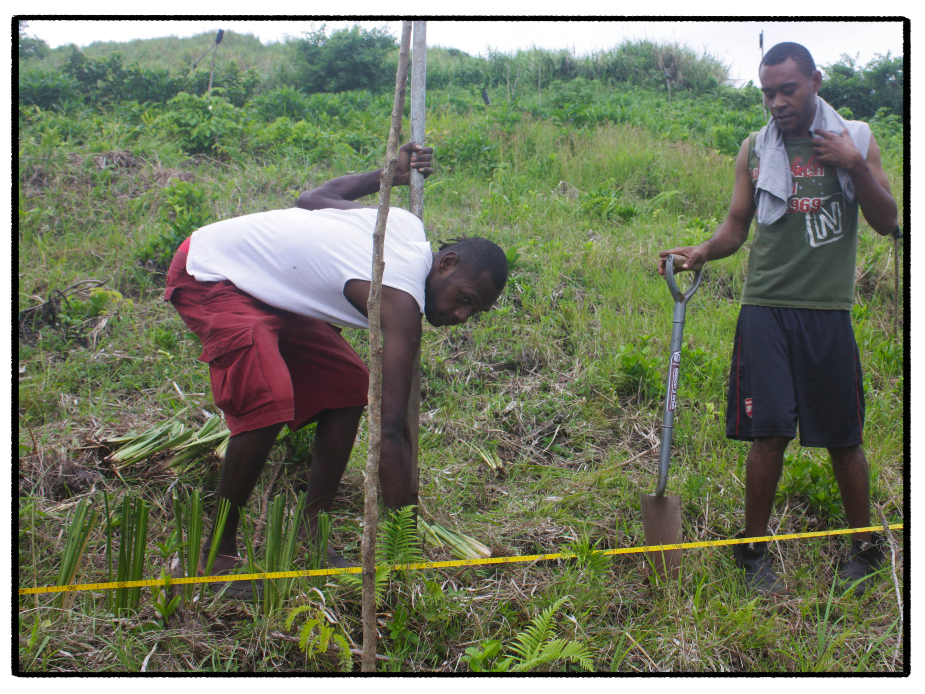
Erosion control. Pele Island, Vanuatu. Image: SPC/GIZ CCCPIR 2012
Notes:
Soil erosion, landslides and coastal erosion are a big problem for many communities in the Pacific, causing serious damage to infrastructure (such as houses, roads and airstrips) and livelihoods, and threatening food and water security. Cyclones, storms, flooding, very wet conditions and changes in sea levels can further increase the risk and intensity of erosion.
There are many ways that Pacific communities can reduce the risk and severity of erosion, both inland and on the coast. The SPC-GIZ climate change program is working with communities on Pele Island in Vanuatu to design and implement a community forest nursery intended to produce soil‐stabilising tree species to minimise erosion problems. This picture shows community members on Pele Island taking early action and re-vegetating a hillside with vetiver grass.

Slide 23
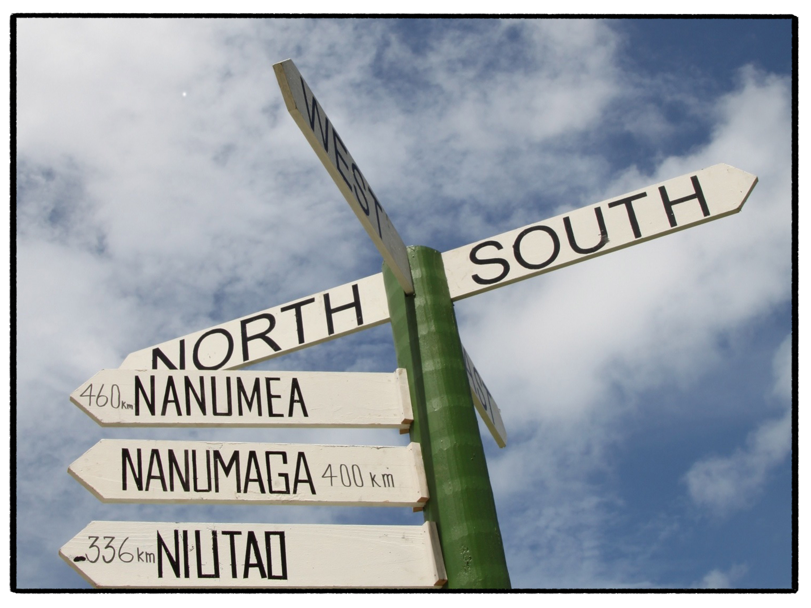
Education & radio advisories. Funafuti, Tuvalu. Image: Red Cross 2012
Notes:
The regional office of International Federation of Red Cross and Red Crescent Societies in Suva, Fiji, uses regional seasonal climate updates and keeps a close eye on the status of El Niño and La Niña events as they develop. They link the potential low or high rainfall periods to specific actions that Red Cross National Societies can take at a national and community level. For example during the 2010–11 La Niña events, the Tuvalu Red Cross used information of probable dry conditions to trigger advisories on the best use of water in its regular radio programme, in conjunction with a hand-washing campaign to minimize diarrhoea outbreaks. The Tuvalu Red Cross has more recently worked in conjunction with the Tuvalu Meteorological Office to erect signs on Funafuti that have been used to educate school children about directions used in weather warnings.

Slide 24
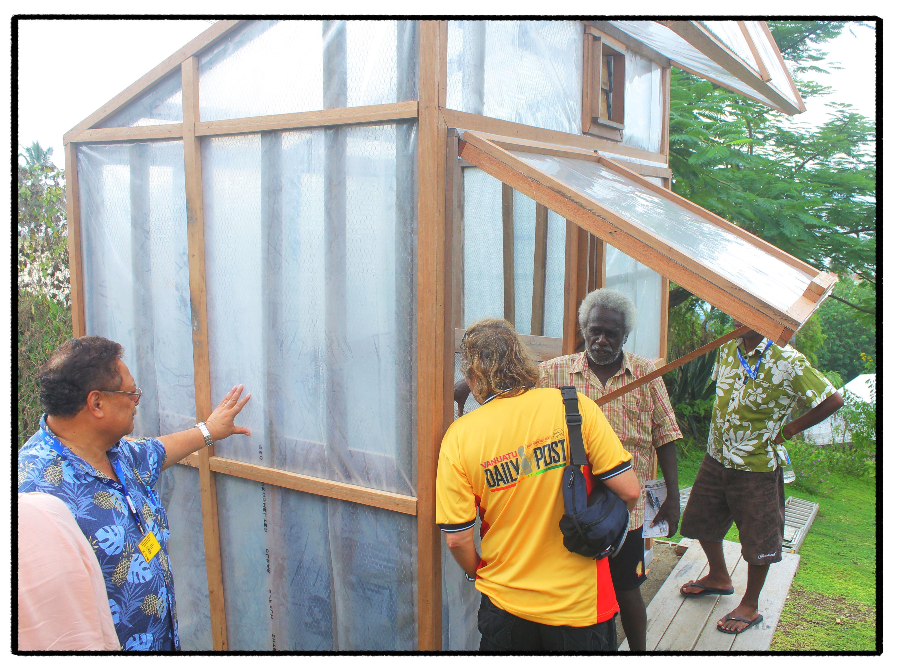
Food preservation. Honiara, Solomon Islands. Image: PACC Solomon Islands 2013
Notes:
Very wet or very dry conditions, along with extreme events like cyclones, can have serious impacts on food security. Food preservation is one early action that can be taken to prepare for times when there is little food available. There are many ways that different foods can be preserved.
This picture shows one of the solar driers that have been developed as part of the PACC Solomon Islands project. This prototype design, along with another ‘hybrid solar drier’ for use in cloudy conditions or bad weather, will be replicated and used by communities to dry root crops for food processing. The processed cassava or root crops can then be stored and used later in times of food shortage or natural disasters.

Slide 25
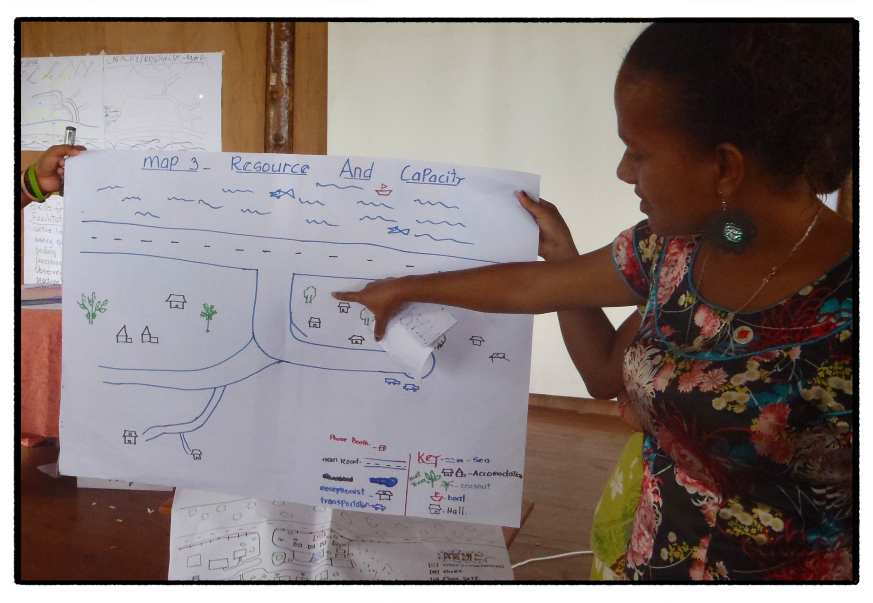
Hazard mapping & community profiling. Viti Levu, Fiji. Image: Red Cross 2012
Notes:
In the northern division of Viti Levu, the Fiji Red Cross has been using participatory tools such as focus group discussions, mapping and transect walks to help communities identify hazards and create community profiles. These profiles are then used to identify community led projects to reduce risk and increase the safety of community members.

Slide 26
