Slide 1
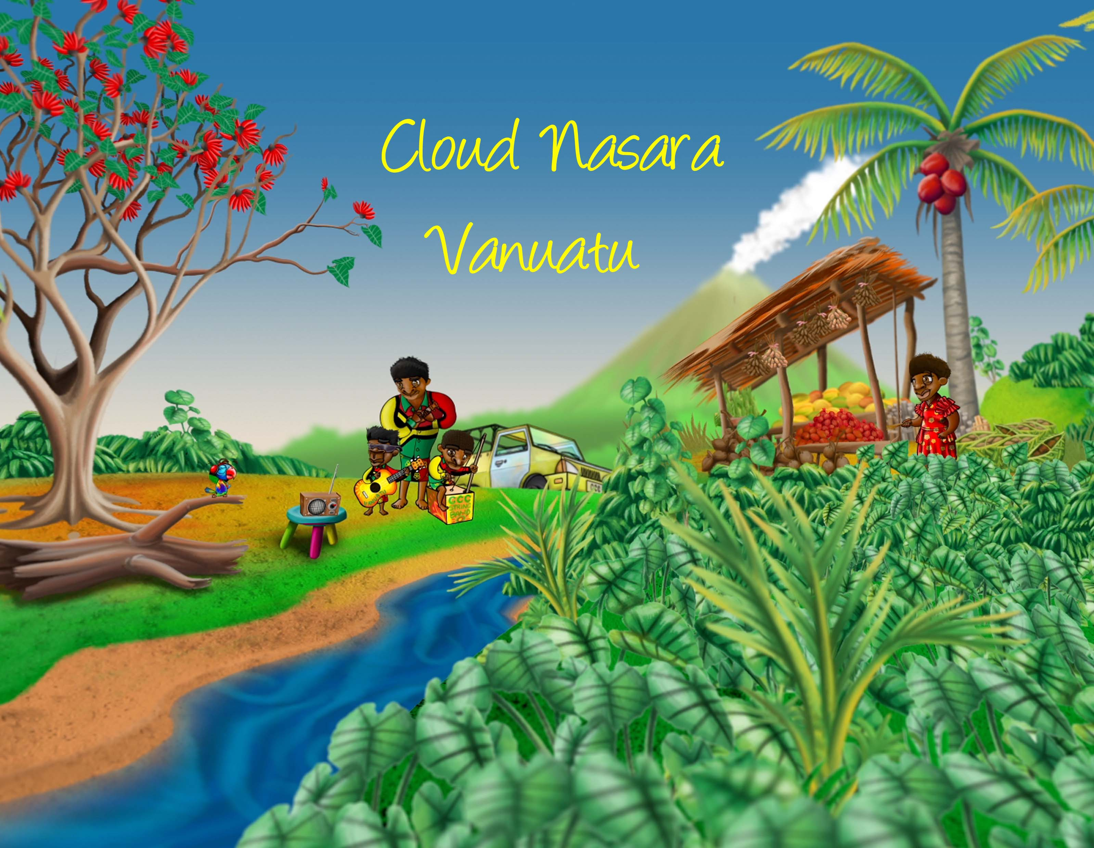
Notes:
Welcome to the Cloud Nasara!

Slide 2

Weather and climate
Climate variability and climate change
Different time scales and forecasts
Early warning, early action
Vanuatu’s changing climate
Vanuatu’s future climate
For more information

Slide 3
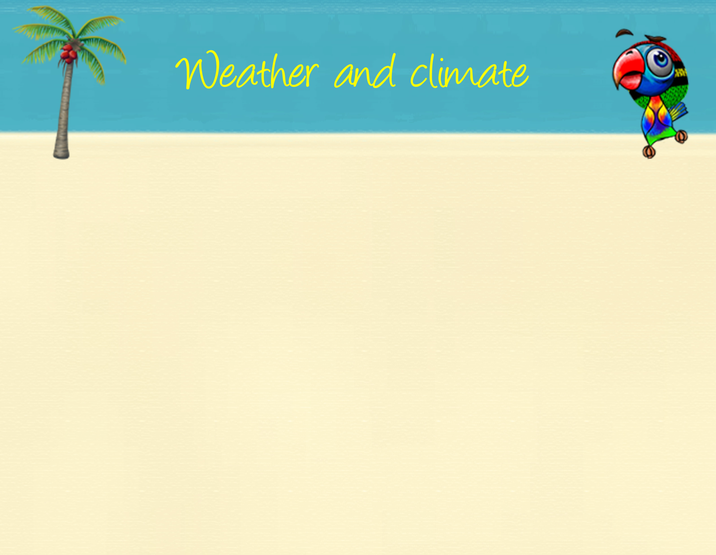
Weather describes the current atmospheric conditions, e.g. rainfall, temperature or wind speed at a particular place and time
Climate is the average pattern of weather for a particular place over a long period of time (e.g. 30 years)
‘Climate is what we expect. Weather is what we get!’
Notes:
Weather refers to atmospheric conditions such as temperature and rainfall over a short period of time – a few hours or a few days. Weather changes from day to day and the changes are easy to see. Climate, on the other hand, is the average pattern of weather for a particular place measured over a long period of time, usually at least 30 years. Changes in climate are not easy to detect, they require careful measurement with special instruments over long periods of time. One easy way to remember the difference between climate and weather is by using the phrase ‘Climate is what we expect. Weather is what we get!’

Slide 4
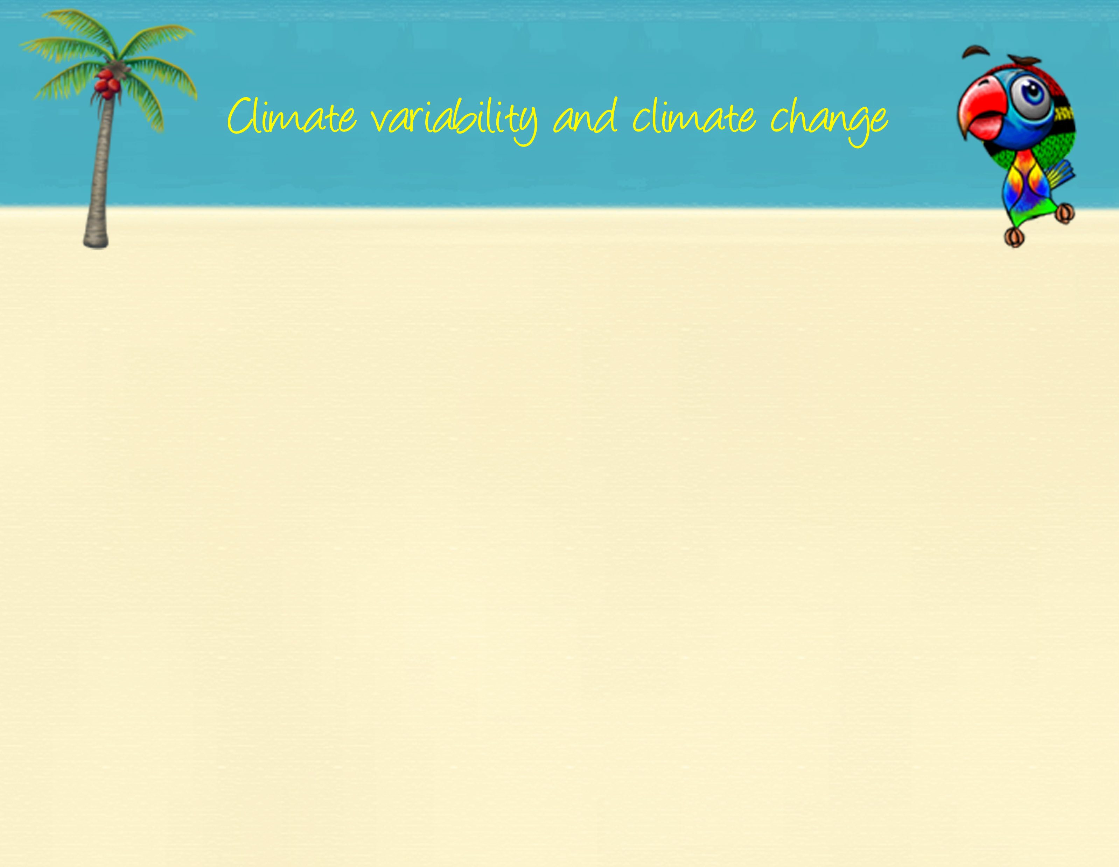
Climate variability is monthly, yearly and decadal variability due to natural processes and feedbacks. The main driver of climate variability in the Pacific region is the El Niño Southern Oscillation (ENSO).
Climate change is a long-term shift or trend in climate conditions (e.g. global warming) and can produce shifts in averages, extremes and variability of temperature, rainfall, sea level and other variables.
Climate variability and climate change can occur independently, but also at the same time.
Notes:
Climate variability is variability that is due to natural processes and feedbacks and can occur on monthly, yearly and decadal timeframes. There are many features of the climate in the Pacific that influence this variability, including cloud meeting places like the South Pacific Convergence Zone, the Intertropical Convergence Zone and the West Pacific Monsoon. The main driver of climate variability in the Pacific region is the El Niño Southern Oscillation (ENSO) or the swing between El Niño, La Niña and neutral conditions.
Climate change is a long-term shift or trend in climate conditions (e.g. global warming) and can produce shifts in averages, extremes and variability of temperature, rainfall, sea level and other variables. Climate variability and climate change can occur independently, but also at the same time – so while the climate is getting warmer there will still be variability in temperature with cool days and warm days – it’s the average climate that is getting warmer.

Slide 5


Climate change
Climate variability
Weather
hours
days
months
years
decades
centuries
Rain storm
Wet season &
dry season
Tropical cyclone
El Niño and La Niña
Global warming
&
ocean acidification
Notes:
One way to understand the difference between weather, climate variability and climate change is to think about how they operate on different time scales.
The big arrow refers to different periods of time – days, months, years, decades and centuries. We can see here that weather refers to hours, days and maybe months; climate refers to months, years and decades and climate change refers to decades and centuries. Examples of weather are rain storms that might last one or two hours and tropical cyclones that may last days. Climate variability can be defined by climate patterns such as the El Niño and La Niña and climate change refers to things which happen over centuries, like global warming.

Slide 6

Forecasts can be available hours, days, weeks, months, or even decades in advance.
For example, the Vanuatu Meteorology and Geo-hazard Department could release a severe weather warning for the next 24 hours, forecasting winds of 40 to 50km an hour and very heavy rainfall with a chance of flooding in some areas, or they could issue a seasonal forecast, predicting a strong El Niño in the Pacific and forecasting below average rainfall in Vanuatu over the coming three months.
Notes:
Forecasts can be available hours, days, weeks, months, or even decades in advance.
For example, the Vanuatu Meteorology and Geo-hazard Department could release a severe weather warning for the next 24 hours, forecasting winds of 40 to 50km an hour and very heavy rainfall with a chance of flooding in some areas, or they could issue a seasonal forecast, predicting a strong El Niño in the Pacific and forecasting below average rainfall in Vanuatu over the coming three months.

Slide 7

more specific information
Climate change
rising risks, trends, more surprises
Decades, end of century
Longer
lead time
Seasonal forecasts
level of risk in coming months
next 3-6 months
Weather forecasts
impending hazard
10 days or less
Shorter
lead time
more time to reduce risk
Notes:
Climate and weather information is an important tool that we can use when taking action to prepare for extreme events. We can use information and forecasts across different time scales. Longer lead-time forecasts can only tell you if there is an increased risk, but at the same time, they give you much more time to prepare and reduce risk. Shorter lead-time forecasts can give you more specifics in terms of where and when an extreme might occur, but you will have much less time to prepare and reduce risk. Different actions may be more appropriate for different time scales.

Slide 8

Climate and weather information can help us anticipate and prepare for changing risks.
Early warning, early action is about making use of climate and weather information before a disaster or extreme event strikes and acting sooner than you would do without this information.
Notes:
We can use climate and weather information to help us anticipate and prepare for changing risks due to extreme events or disasters.
Early warning early action is about taking smart action and making use of climate and weather information before a disaster or extreme event strikes. Early warning early action is about acting sooner than you would if you didn’t have this information. It is important to understand what is happening to the climate around you and what is likely to happen in the future.

Slide 9
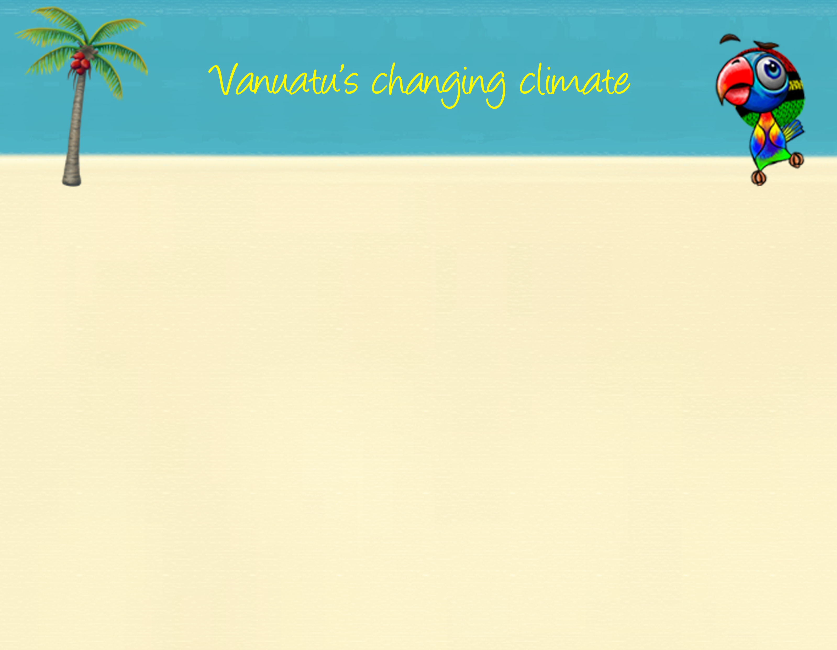
Temperatures have increased
Sea level has risen
Ocean acidification has been increasing
Notes:
The climate has an impact on all of our lives in Vanuatu and our climate is changing. Scientists from the Meteo and overseas have noticed the following changes in Vanuatu’s climate. Temperatures have increased in Port Vila and Aneityum since 1950. These increases are consistent with the global pattern of warming. The changing climate has impacted Vanuatu’s waters as well. Our sea levels have risen by about 6mm per year since 1993 and ocean acidification has been increasing. Ocean acidification happens as the ocean absorbs more and more carbon dioxide. As our seas become more acidic, our coral reef ecosystems are threatened.

Slide 10

Temperatures will continue to increase
More very hot days
Changing rainfall patterns
More extreme rainfall days
Less frequent but more intense tropical cyclones
Sea level will continue to rise
Ocean acidification will continue to increase and threaten coral reef ecosystems
Notes:
Future changes in Vanuatu’s climate will have big impacts on all of our lives. Understanding the possible future climate of Vanuatu is important so communities, organisations, government and businesses can all plan for change. Scientists have come up with the following ‘projections’ for Vanuatu’s future climate. Temperatures will continue to increase and we are likely to have more hot days. Our rainfall patterns will change and it is likely that we will experience more extreme rainfall days. It is likely that by the late 21st century, we will have less frequent but more intense tropical cyclones. The sea level will continue to rise and our coral reef ecosystems will be under increased threat as our oceans become more and more acidic.

Slide 11

For more detailed information on the changes in the current and future climate of Vanuatu, visit www.pacificclimatechangescience.org or contact the Vanuatu Meteorological and Geo-hazard Department (VMGD).
Notes:
For more detailed information on the changes in the current and future climate of Vanuatu, visit www.pacificclimatechangescience.org or contact the Vanuatu Meteorological and Geo-hazard Department (VMGD).

Slide 12
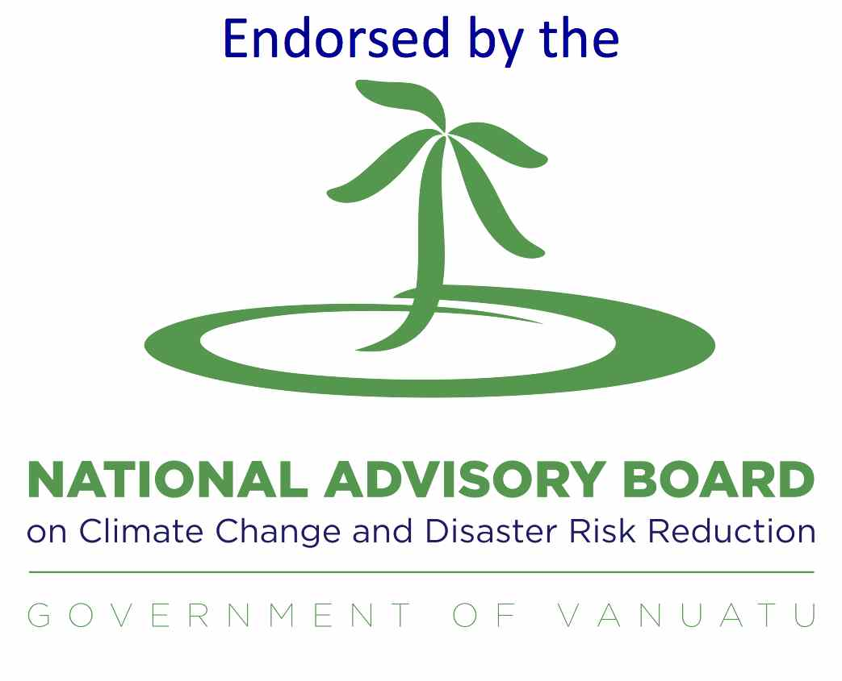

Cloud Nasara is a collaboration between Red Cross and the Australian Government’s Pacific-Australia Climate Change Science and Adaptation Planning (PACCSAP) Program. The project is being implemented by the Red Cross, the Australian Bureau of Meteorology, the Commonwealth Scientific and Industrial Research Organisation (CSIRO), the Vanuatu Meteorology and Geo-hazard Department (VMGD) and the SPC-GIZ Climate Change Program.

Slide 13


Slide 14
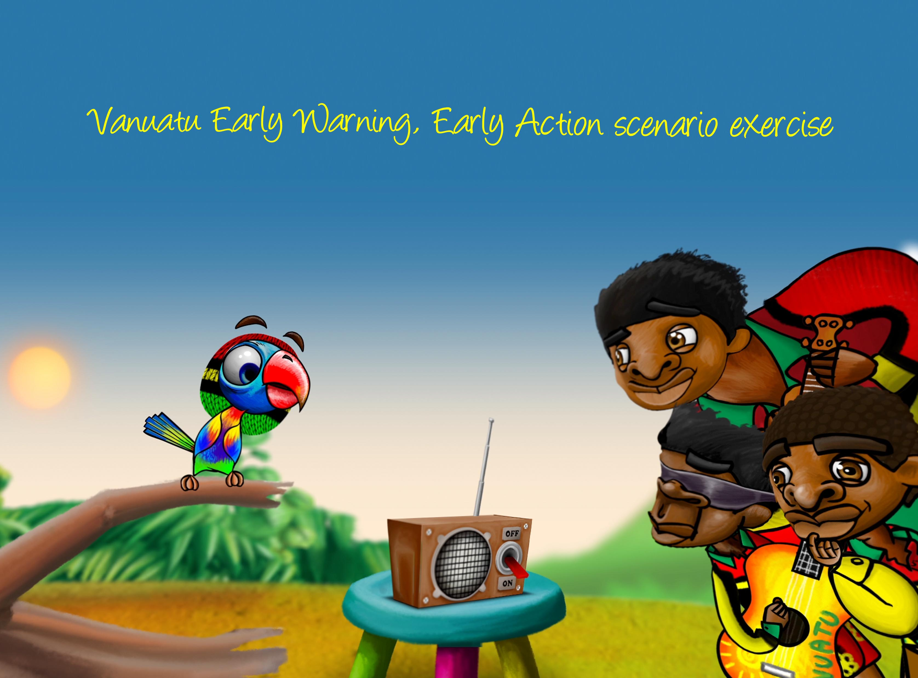

Slide 15
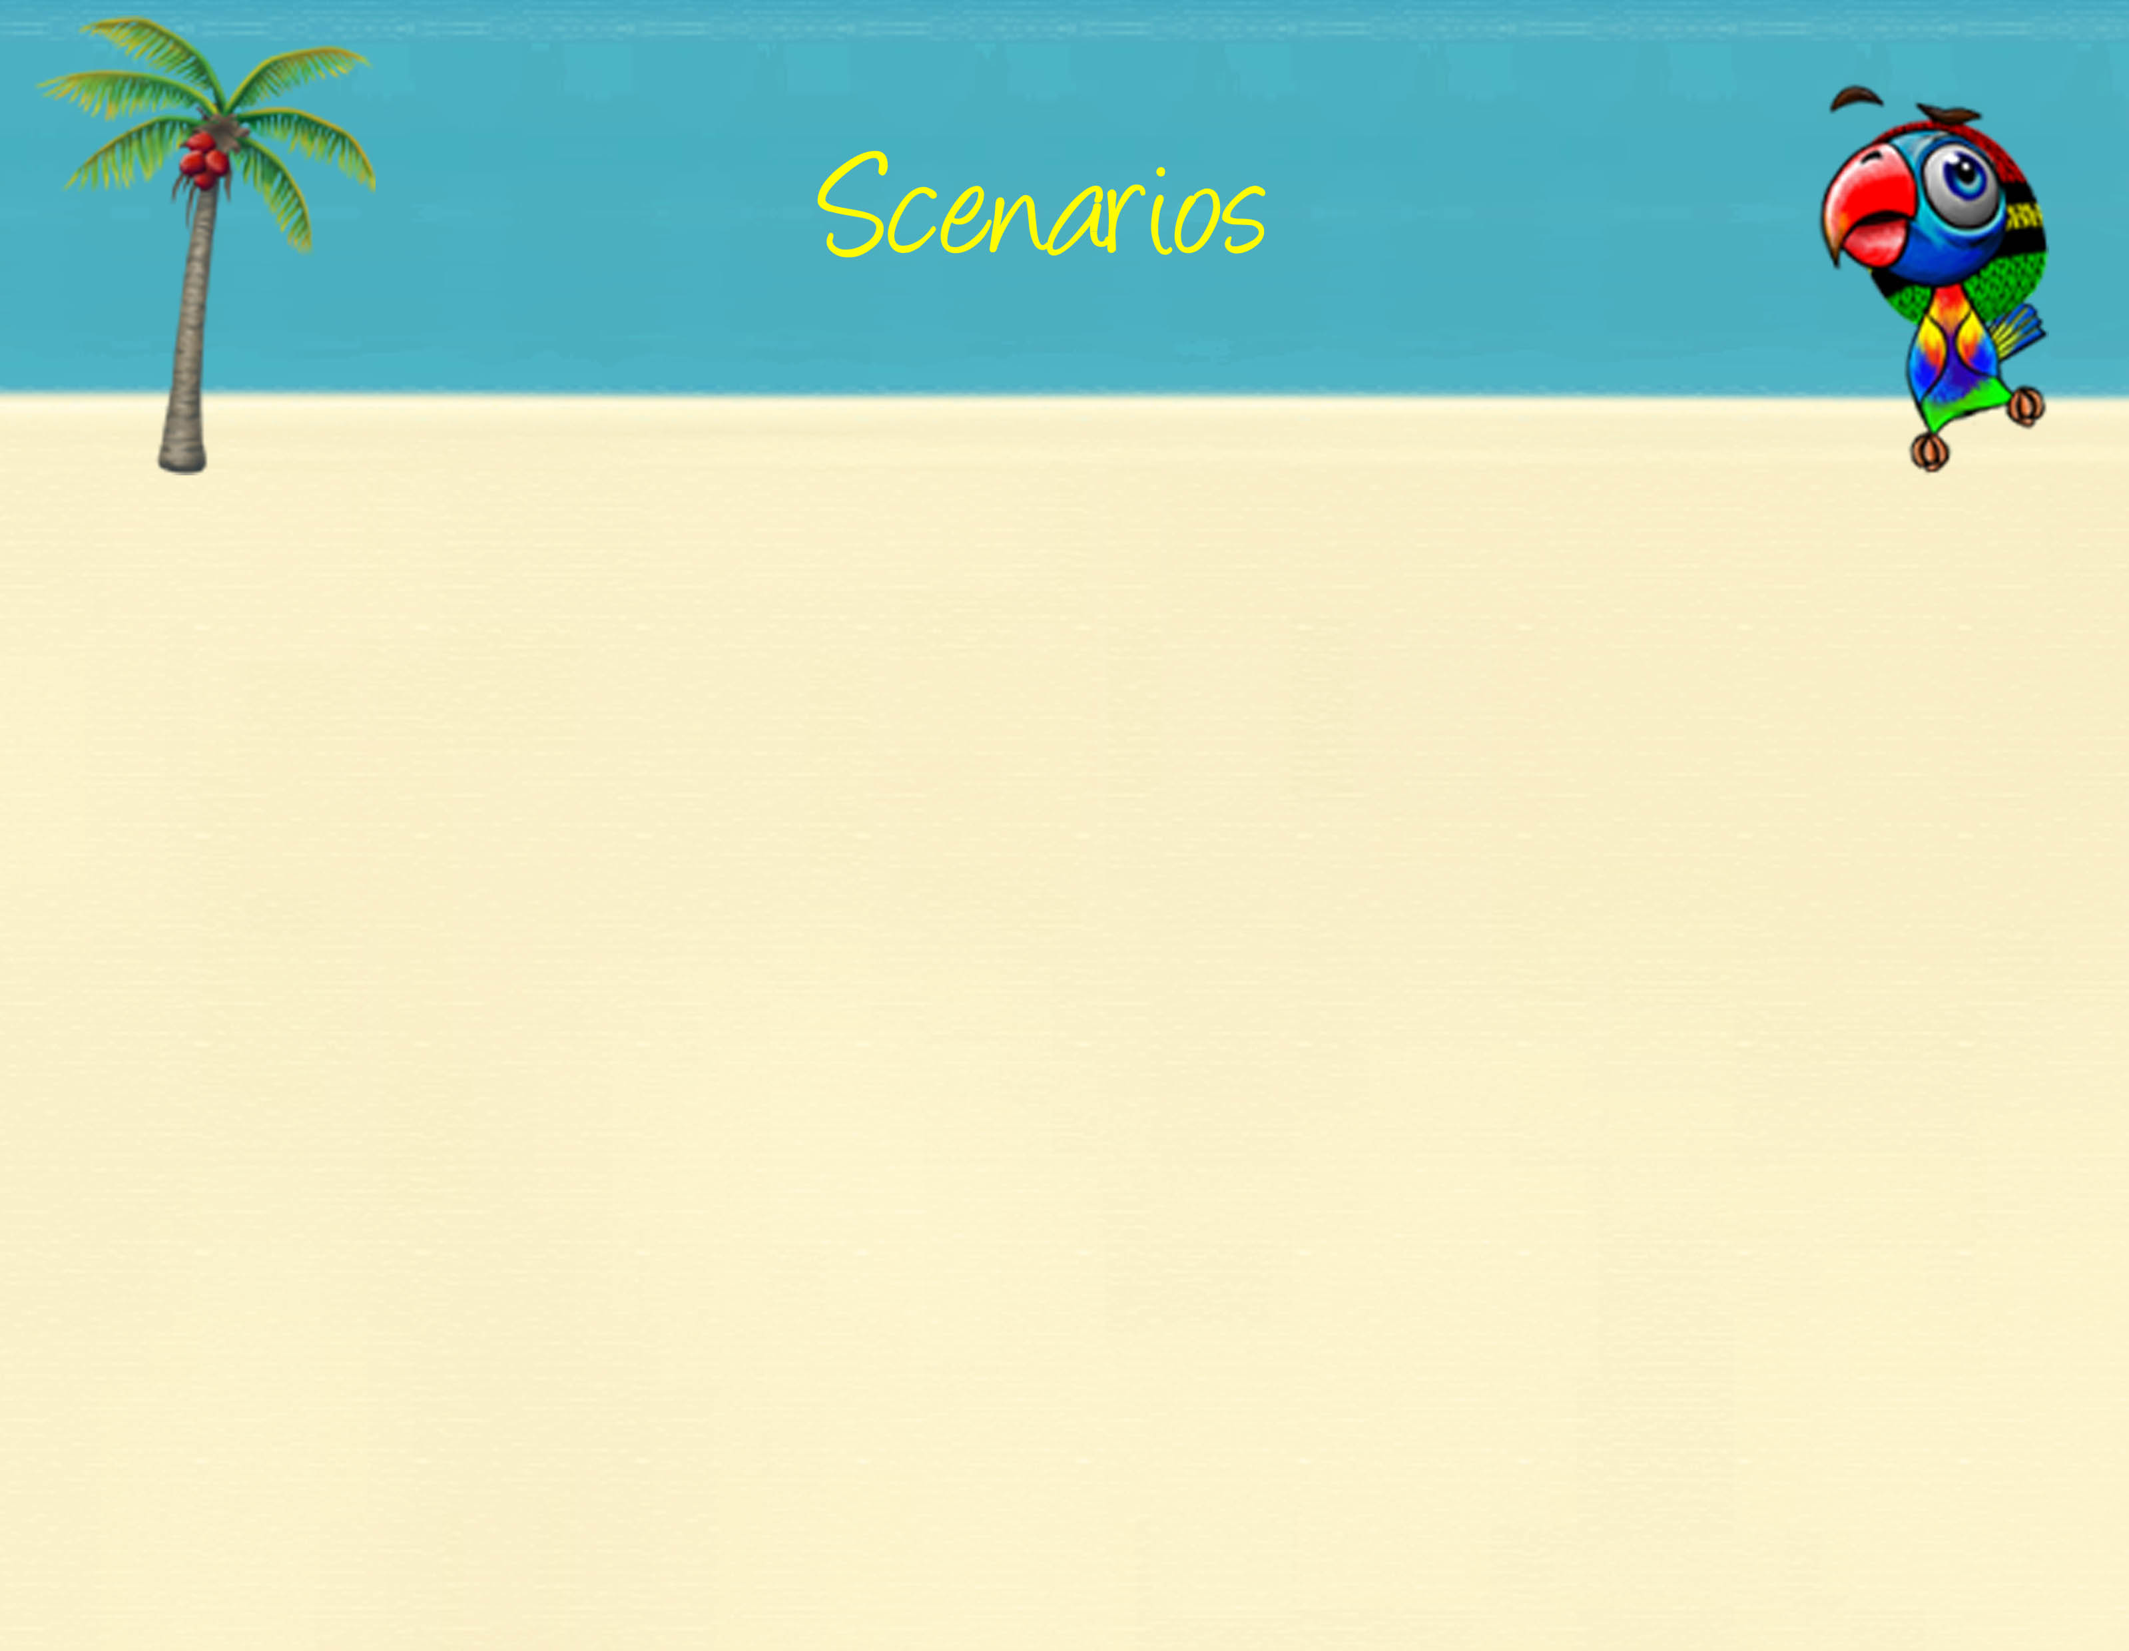
Seasonal forecast scenarios
Scenario 1: Above average rainfall
There is a La Niña in the Pacific. The VMGD forecasts above average rainfall for the coming three months in your province. High rainfall and floods may be possible.
Scenario 2: Below average rainfall
There is an El Niño in the Pacific. The VMGD forecasts below average rainfall for the coming three months in your province. They also release a drought advisory stating that most islands in Vanuatu may experience water shortages and that drought conditions are expected for the next six months. They advise people to take measures to minimise the impact of drought.
Scenario 3: Cyclone season
It is the beginning of the rainy season in Vanuatu. VMGD releases the tropical cyclone outlook for the season. There are 9 – 12 tropical cyclones forecast for the Pacific region and Vanuatu is likely to experience close to normal or slightly above normal tropical cyclone activity. The VMGD forecasts that 2 – 4 cyclones may affect the country. The VMGD asks the people of Vanuatu to remain vigilant at all times during this cyclone season.

Slide 16
Weather forecast scenarios
Scenario 4: Severe weather warning
It is the middle of the rainy season in Vanuatu. The VMGD releases a severe weather warning. Winds of 65 km/hour are expected inland over Vanuatu in the next 24 – 36 hours and heavy rain is forecast to continue for much of Vanuatu. Flooding is expected over low-lying areas and areas close to riverbanks. High seas and marine wind warnings are also in place.
Scenario 5: Tropical cyclone warning
It is cyclone season and a Category 3 cyclone is approaching Vanuatu. The VMGD and the National Disaster Management Office (NDMO) release an updated warning on Tropical Cyclone Frank. At 2:00pm today, Severe Tropical Cyclone Frank was located in square letter D, number 1 (D, 1) of the Vanuatu tropical cyclone tracking map and is moving in a general southeasterly direction. Very Destructive Storm to Hurricane force winds of 110km/hour to 145km/hour are forecast over the next 24 – 48 hours. Heavy rainfall and flooding, including coastal flooding is also expected. Very rough seas with phenomenal (very large) swells are expected over all open waters of Vanuatu. The next warning on Severe Tropical Cyclone Frank will be issued at 6:00pm. People over Vanuatu should continue to listen to all Radio Outlets to get the latest information on this system.

Slide 17
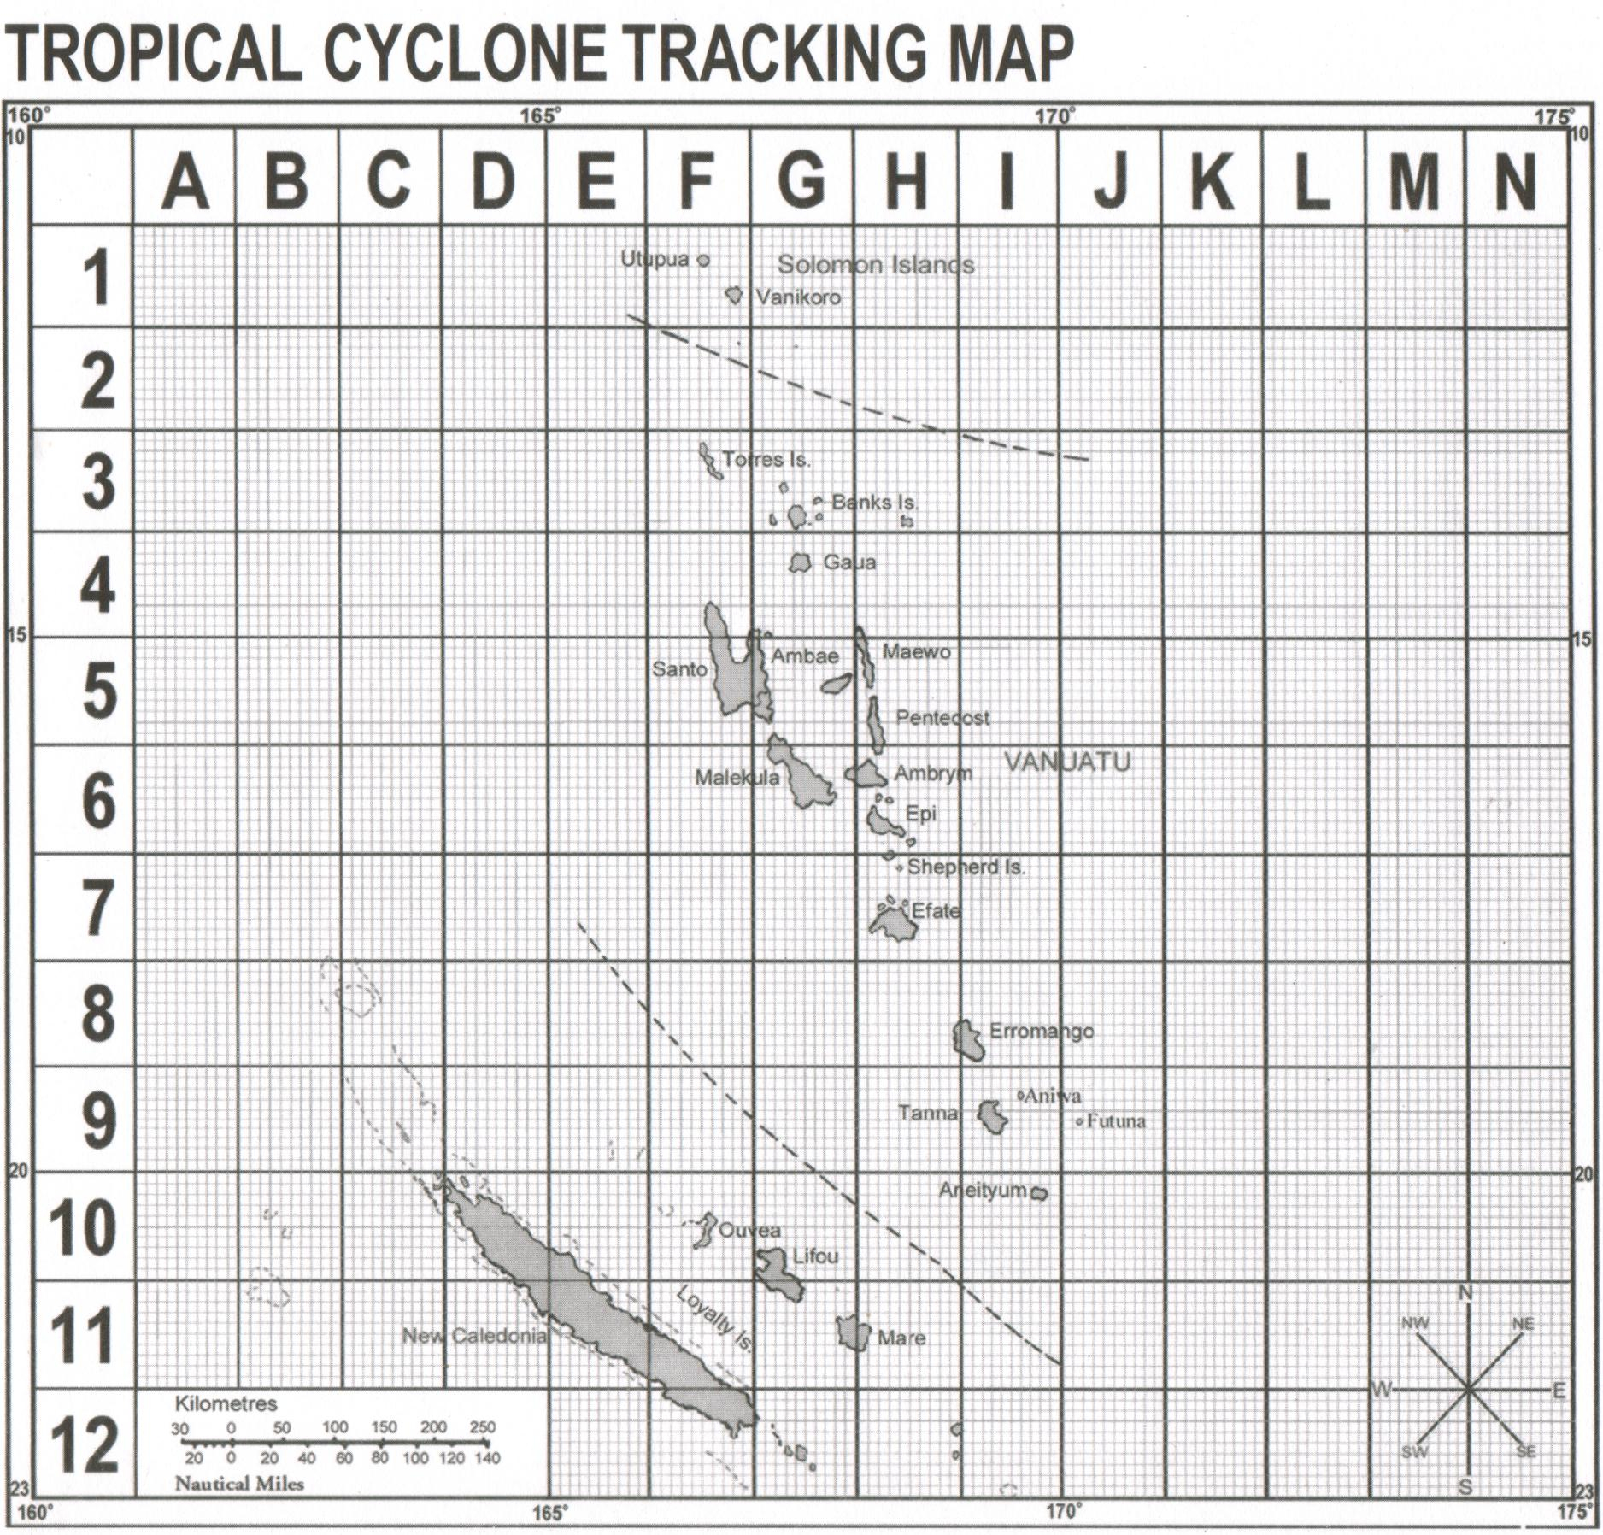

Slide 18

1. Impacts
List the typical impacts of this scenario on your organisation or sector.
  Can you remember a time that this has happened before?
  What economic impacts could this scenario have?
  What impacts could this scenario have on resource access and availability (for example, food, water and electricity), staff or volunteer capacity, health and safety, infrastructure (for example – roads, buildings and airports) and the way that resources are managed?
2. Information
Where can you get warnings and more information about this scenario?

Slide 19
3. Solutions
  Think about existing responses to these impacts. What works well that can be done more? What can be done differently or better next time?
  What no cost or low cost actions can be taken in the near future to prepare for this scenario?
  How would you make sure these actions are implemented in your workplace into the future (not once-off)? Is there a way to make these actions part of the standard procedures in your workplace?
  Which other organisations, departments or businesses could you talk to and work together with to take action?

Slide 20
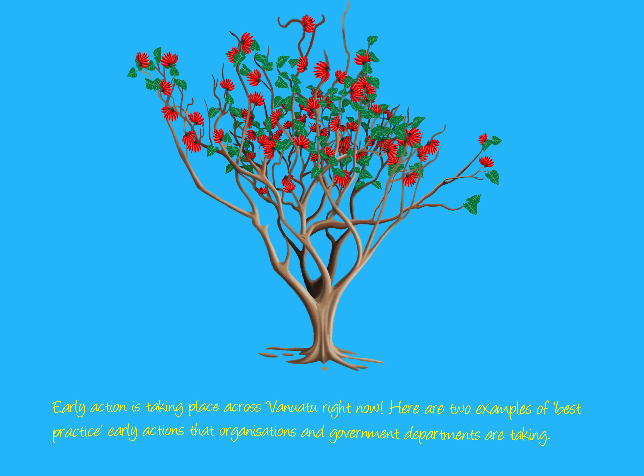
Notes:
Early action is taking place across Vanuatu right now! Here are two examples of ‘best practice’ early actions that organisations and government departments are taking.

Slide 21
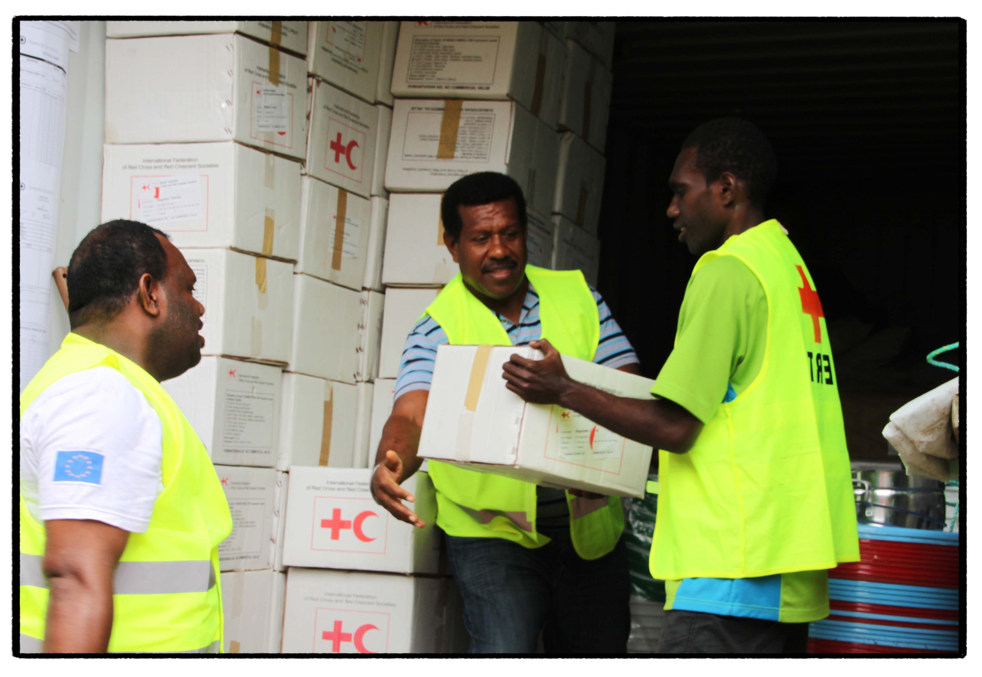
Notes:
Vanuatu Red Cross has five shipping containers and two storage houses located throughout the country. These are stocked with essential disaster-relief items such as tarpaulins, rope, water containers, shovels and cooking utensils. Every three months Vanuatu Red Cross staff undertake stock takes of all materials and make sure sufficient supplies are in place to be ready for disaster response. A Pacific-wide stock take is done by all Red Cross Societies, including Vanuatu Red Cross, before the cyclone season starts in November each year. Forecasts are then closely monitored for tropical depressions during November to April each year.

Slide 22
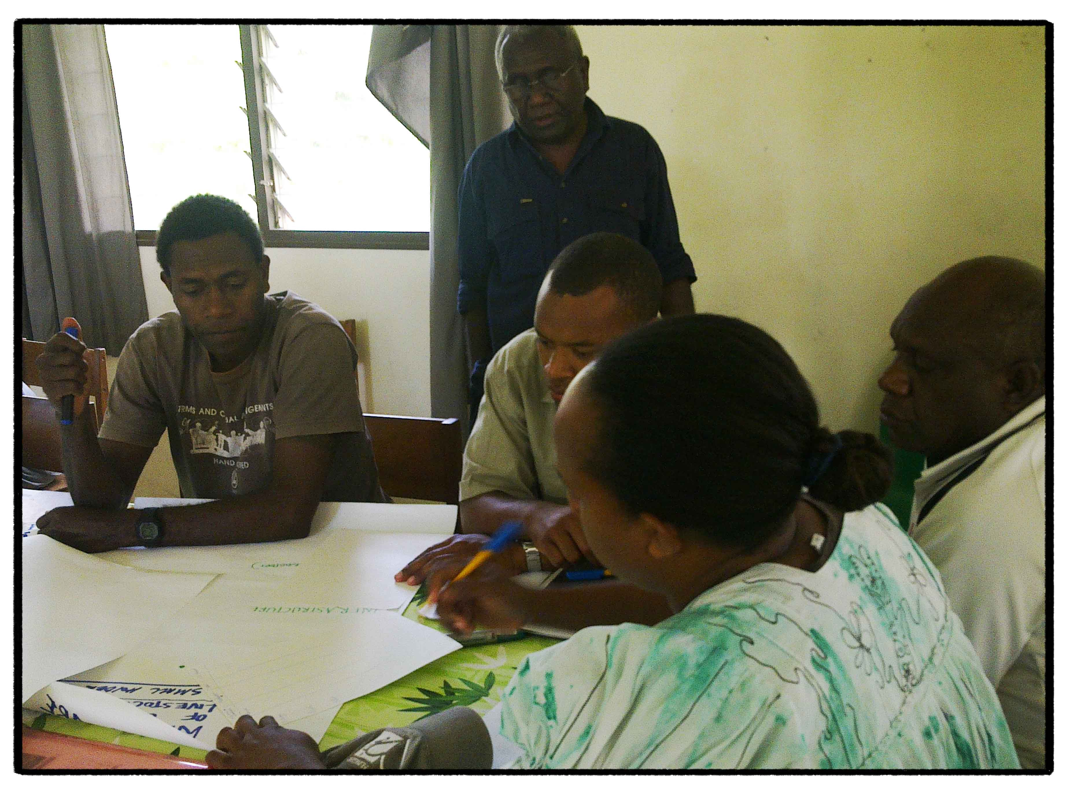
Notes:
The Vanuatu Departments of Agriculture and Livestock have been working with the Vanuatu Meteorology and Geo-hazard Department to take early action. This image shows staff discussing different climate and weather scenarios (for example, an El Niño event) and developing strategies and action plans to prepare for specific events.

