Slide 1
Notes:
Welkam long Klaod Nasara

Slide 2
Weta mo klaemet
Klaemet variability mo klaemet jens
Ol difren taem scale mo fokast
Early woning, early aksen
Ol jenis blong klaemet blong Vanuatu
Ol fiuja klaemet blong Vanuatu
Blong moa infomesen

Slide 3
Weta i minim se ol kondisen blong skae we yumi karem naoia olsem ren, tempereja o winspid long wan ples long wan taem
Klaemet hemi ol averej blong weta long wan ples ova long wan longfala taem (olsem 30 yia)
‘Klaemet hemi wanem bae yumi ekspektem. Weta hemi wanem yumi karem!’
Notes:
Weta i minim ol kondisen blong atmosphere olsem tempereja mo ren long wan sot period blong taem – long few hours o few dei. Weta i jenis long evri dei mo ol jenis ia i isi blong luk. Klaemet, long narahand, hemi averej paten blong weta blong wan ples we yumi meserem long wan longfala taem, olsem long 30 yia. Ol jenis long klaemet hemi no isi blong luk o detektem, olgeta i nidim ol gudfala measurement long wan longfala taem wetem ol stret instrument. Wan isi wei blong rimemba wanem hemi weta wetem klaemet hemi blong usum toktok ia ‘Klaemet hemi wanem bae yumi ekspektem. Weta hemi wanem yumi karem!’

Slide 4
Klaemet variability hemi wanem i hapen long manis, wan yia mo ol jenis we i hapen long klaemet long ten yia, we i kam aot or go bak long ol jenis we oli stap hapen long nature. Main driva blong klaemet variability long Pasifik hemi El Niño Southern Oscillation (ENSO).
Klaemet jens hemi wan long-term shift o trend long klaemet kondisen (olsem global woming) mo i save mekem ol jenis long ol averej, ol extreme mo variability long ol tempereja, ren, level blong solwota mo ol nara variable.
Klaemet variability mo klaemet jens oli save hapen wanwan (no tugeta) mo oli save hapen long semtaem.
Notes:
Klaemet variability hemi ol jenis long klaemet we i kamaot naturally long ol processes wetem ol feedback blong hem mo i save hapen long evri manis, yia mo evri ten yia. I gat ol features blong klaemet long Pasifik we i influencem ol variability ia, olsem klaod nasara o wanem yumi save long hem olsem South Pacific Convergence Zone mo West Pacific Monsoon. Ol main driva blong klaemet variability long Pasifik region hemi El Niño Southern Oscillation (ENSO) o ol swing bitwin El Niño, La Niña mo neutral kondisen.
Klaemet jens hemi wan long term jenis long klaemet kondisen (olsem global woming) mo i save mekem ol jenis long averej, extreme mo variability blong tempereja, renfol, level blong solwota wetem ol nara variable. Klaemet variability mo klaemet jens oli hapen wanwan be oli save hapen tu long semtaem – so taem klaemet i stap wom bae i still gat variability long klaemet wetem ol dei we i kolkol mo wom – hemi averej blong klaemet we i stap kam moa wom.

Slide 5
Klaemet jens
Klaemet variability
Weta
Hour
Dei
Manis
Yia
Ten yia
Wan hundred yia
Ol bigfala ren
Wet sisen mo
drae sisen
Tropikol saeklon
El Niño mo La Niña
Global woming
mo
asid long solwota
Notes:
Wan wei blong yumi save long difrens bitwin weta wetem klaemet, klaemet variability mo klaemet jens hemi blong tinkbaot hao oli wok long ol difren taem scale. Bigfala arrow hemi refer long ol difren taem – ol dei, manis, yia, ten mo wan hundred yia. Yumi save luk long ples ia se weta i refer i go long hour, ol dei mo bae yumi save putum tu se long manis; klaemet hemi refer i go long manis, o kasem ten yia mo klaemet jens i refer i go long ten mo one hundred yia. Ol exambol blong weta hemi ol ren we i save stap wan o tu hour mo tropikol saeklon we i save stap long samfala dei. Klaemet variability yumi save talem olsem ol paten blong klaemet olsem El Niño mo La Niña mo klaemet jens i refer i go long ol samting we i hapen ova long wan hundred yia olsem global woming.

Slide 6
Fokast hemi save avelebol ol hour, dei, manis o even kasem ten yia.
Wan exambol, Vanuatu Meteorology mo Geo-hazard Department i save relisim wan rabis weta woning long nekis 24 hours, fokastem ol win blong 40 kasem 50km long wan hour mo ol hevi ren wetem janis blong wota i kam antap long sam eria, o oli save putum aot wan sisenal fokast, we i save prediktim wan strong El Niño long Pasifik mo fokastem ren we hemi below long nomol (averej) long Vanuatu long nekis tri manis we i stap.
Notes:
Ol fokast oli avelebol long hour, dei, wik, manis o kasem ten yia.
Wan exambol, Vanuatu Meteorology mo Geo-hazard Department i save relisim wan rabis weta woning long nekis 24 hours, fokastem ol win blong 40 kasem 50km long wan hour mo ol hevi ren wetem janis blong wota i kam antap long sam eria, o oli save putum aot wan sisenal fokast, we i save prediktim wan strong El Niño long Pasifik mo fokastem ren we hemi below long nomol (averej) long Vanuatu long nekis tri manis we i stap.

Slide 7
Klaemet jens
Ol risk we oli stap kam antap, ol trend, moa surprise
Evri ten yia, end blong century
Ol specific infomesen
Longfala
lead taem
Sisenal fokast
Level blong ol risk long ol manis we i stap kam
Nekis 3-6 manis
Weta fokast
Ol posibol hazard
1 kasem 10 dei
Sotfala
lead taem
Moa taem blong katem daon risk
Notes:
Klaemet mo weta infomesen hemi wan impoten tul we yumi save usum taem yumi tekem aksen blong prepea from ol nogud weta. Yumi save usum infomesen mo ol fokast long ol difren taem scale. Longfala lead taem o ol fokast we yumi putum sam manis bifo wan samting i happen i save talem yu spos bae i gat wan inkris risk, be long semtaem, oli givim yu moa taem blong yu prepea mo redusum risk. Sotfala lead taem o ol fokast we yumi putum aot long wan sot taem bifo wan samting i hapen i save givim yu moa infomesen blong wan event olsem wea mo wanem taem bae rabis weta ia i save happen be yu gat smol taem nomo blong prepea mo redusum risk. Ol difren aksen bae i stret long ol difren taem scale.

Slide 8
Ol infomesen blong klaemet mo weta i save helpem yumi blong luk save mo prepea from ol jensin risk.
Early woning, early aksen hemi blong usum gud ol klaemet mo weta infomesen bifo wan disasta o rabis weta hemi kam mo taem yumi mekem redi ol samting be i no blong yumi wait taem yumi no karem infomesen ia.
Notes:
Yumi save usum klaemet mo weta infomesen blong helpem yumi blong luk save mo prepea from ol risk we i stap jenis from ol nogud weta o disasta.
Early woning early aksen hemi blong tekem ol smart aksen mo usum gud ol klaemet mo weta informesen bifo wan disasta o nogud weta i hapen. Early woning early aksen hemi blong yumi act naoia. Hemi impoten blong andastandem wanem i stap hapen long klaemet raon long yumi mo wanem i save hapen long fiuja.

Slide 9
Ol tempereja oli inkris finis
Level blong solwota hemi kam antap finis
Asid long solwota hemi stap inkris
Notes:
Klaemet i gat ol impak long laef blong ol man Vanuatu mo klaemet blong yumi i stap jenis. Ol man blong stadi long weta mo klaemet (ol scientis) long ofis blong meteo mo long nara kauntri oli luk finis ol jenis long klaemet blong Vanuatu. Ol tempereja i stap go antap long Vila mo Aneityum since long 1950. Ol inkris ia oli semak wetem ol woming we i stap hapen raon long wol. Klaemet we i stap jenis i impaktem ol wota blong Vanuatu tu. Level blong solwota i go antap kasem 6mm long wan yia stat long 1993 mo asid long solwota i stap go antap. Asid long solwota i hapen taem i karem mo carbon dioxide. Taem ol solwota blong yumi i kam mo asid, bae i spoilem ol rif blong yumi.

Slide 10
Ol tempereja bae oli kontinu blong go antap
Moa dei we i hot tumas
Renfol paten i jenis
Moa dei blong extreme renfol
Bae i no gat tumas saeklon be bae oli moa strong
Level blong solwota bae hemi kontinu blong kam antap
Asid long solwota bae i kontinu blong kam antap mo spoilem ol laef blong rif wetem ol samting we i stap long hem
Notes:
Ol fiuja jenis long klaemet blong Vanuatu bae i gat wan bigfala impak long ol laef blong yumi. Hemi impoten blong yumi mas save long ol posibol fiuja blong klaemet blong Vanuatu mekem se ol komuniti, okanisasen, ol ofis blong kavman wetem ol bisnis bae oli save mekem ol plan from ol jenis ia. Ol scientis oli kam antap wetem ol ‘projection’ blong klaemet blong Vanuatu long fiuja. Tempereja bae i kontinu blong go antap mo yumi save kasem moa dei we i hot. Ol paten blong ren blong yumi bae i jenis mo hemi likely se yumi save eksperiensem moa dei we ren i hevi tumas. Hemi likely tu se long en blong 21st century, bae yumi no karem tumas saeklon be olgeta we bae yumi kasem bae oli moa stron. Level blong solwota bae i kontinu blong go antap mo ol rif blong yumi bae oli save ded taem solwota blong yumi i kam mo asid.

Slide 11
Blong moa infomesen long ol jenis long klaemet blong Vanuatu long naoia wetem long fiuja, visitim www.pacificclimatechangescience.org o contactem Dipatment blong Vanuatu Meteorological and Geo-hazard (VMGD).
Notes:
Blong moa infomesen long ol jenis long klaemet blong Vanuatu long naoia wetem long fiuja, visitim www.pacificclimatechangescience.org o contactem Dipatment blong Vanuatu Meteorological and Geo-hazard (VMGD).

Slide 12
Klaod Nasara hemi wan wok we Red Cross wetem wan projek blong kavman blong Australia ‘Pacific-Australia Climate Change Science and Adaptation Planning (PACCSAP) Program’ tufala i mekem. Projek ia oli mekem wetem Dipatment blong Meteo mo Geo-hazard blong Vanuatu (VMGD), Red Cross, Bureau of Meteorology long Australia, Commonwealth Scientific and Industrial Research Organisation (CSIRO) mo SPC-GIZ Climate Change Program.

Slide 15
Ol sisenal fokast scenario
Scenario 1: Renfol we i bitim averej
I gat wan La Niña long Pasifik. VMGD o ofis blong Meteo i fokastem renfol we i bitim averej long tri manis we i stap kam long provins blong yu. Bae i save gat fulap ren mo wota i save kam antap.
Scenario 2: Renfol we i lo bitim averej
I gat wan El Niño long Pasifik. VMGD o ofis blong Meteo i fokastem renfol we i lo bitim averej long tri manis we i stap kam long provins blong yu. Olgeta i putum aot wan woning blong drae taem we i talem se fulap aelan long Vanuatu bae oli no save gat enaf wota mo ples bae i drae tumas long nekis 6 manis. Olgeta i talem long ol man blong tekem sam aksen blong mekem se ol nogud impak blong drae taem ia i no tumas.
Scenario 3: Saeklon sisen
Hemi stat blong taem blong ren (reni sisen) long Vanuatu. VMGD hemi putum aot tropikol saeklon fokast blong sisen ia. I gat 9 – 12 tropikol saeklon we bae i save hapen long yumi long Pasifik region mo Vanuatu bae i save gat klosap o bitim nomal tropikol saeklon aktiviti. Ofis blong Meteo i stap fokastem blong 2 – 4 saeklon i save afektem Vanuatu. Ofis i askem ol pipol blong Vanuatu blong yu redi oltaem long sisen blong saeklon ia.

Slide 16
Ol weta fokast scenario
Scenario 4: Nogud weta woning
Hemi midel blong sisen blong ren long Vanuatu. VMGD hemi putum aot wan nogud weta woning. Win we bae i save kasem 65 km/hour yumi espectem insaed long ol aelan long nekis 24 – 36 hour mo hevi ren oli fokastem blong kontinu long planti ples long Vanuatu. Wota bae i save kam antap long ol ples we i low mo klosap long ol riva. I gat wan sea (hae sea) mo win woning long solwota we hemi stap naoia.
Scenario 5: Tropikol saeklon woning
Hemi saeklon sisen mo i gat wan category 3 saeklon i stap kam long Vanuatu. VMGD wetem Nasonal Disasta Manejmen Ofis (NDMO) i putum aot wan woning long tropikol saeklon Frank. Long 2:00 long aftanun tedei, tropikol saeklon Frank hemi stap long square leta D, namba 1 (D, 1) long tropikol saeklon traking map mo i stap muv long wan saot-is direksen. I gat ol storm force win kasem hurricane force win we oli stat long 110km/hour kasem 145km/hour oli fokastem blong nekis 24 – 48 hour. Yumi expectem blong karem hevi ren wetem flading long ples we i lo mo klosap long solwota. Solwota bae i raf wetem ol bigafala wav long ol open solwota blong Vanuatu. Nekis woning long tropikol saeklon Frank bae i kamaot long 6:00pm. Ol man long Vanuatu oli mas lisen oltaem long radio blong karem ol niufala infomesen long saeklon ia.

Slide 17
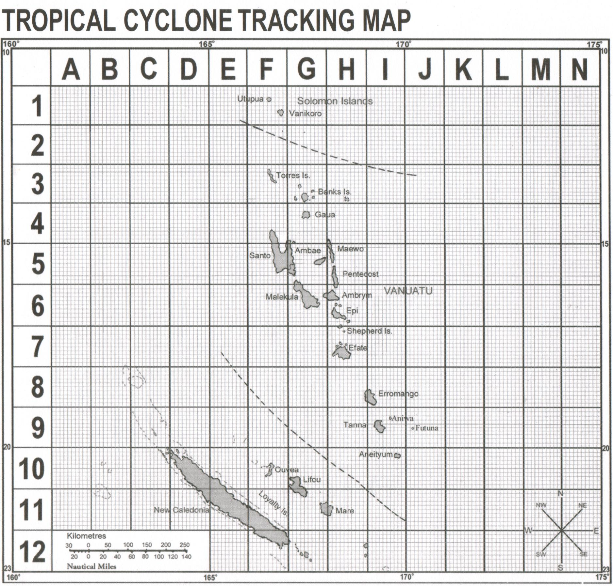

Slide 18
1. Ol impak
Givim sam impak long scenario ia long okanisasen o sekta blong yu.
Yu save rimemba wan taem we samting olsem ia i hapen bifo?
Wanem kaen ekonomik impak scenario ia i save gat?
Wanem kaen impak scenario ia i save gat long access mo availability long ol risos (olsem, kakai, wota mo eletrik), capacity blong wan ofisa, helt wetem sefti, infrastrakja (olsem - rod, ol house mo aeport) mo ol wei we yumi manajem ol risos?
2. Infomesen
Wea yu save karem ol woning wetem ol infomesen long scenario ia?

Slide 19
3. Solusen
Tinkbaot ol ‘response’ we i stap. Wanem i wok gud we yumi save mekem mo long hem? Wanem yumi save mekem blong i kam moa gud nekis taem?
Wanem kaen aksen we hemi no nidim mani o smol mani nomo we ol man i save mekem long fiuja blong prepea from scenario olsem?
Hao yu save mekem sua se ol aksen ia oli mekem long ples blong wok blong yu long fiuja (no wantaem nomo)? I gat eni nara wei blong mekem ol aksen ia i kam pat blong fasin blong wok long ples blong wok blong yu?
Wanem ol nara okanisasen, ofis blong kavman o bisnis we yu save toktok mo wok wetem olgeta blong tekem aksen?

Slide 20
Notes:
Early aksen hemi tekem ples raon long Vanuatu naoia! I gat tu eksambol blong ol ‘gudfala practis’ early aksen we ol okanisasen mo ol ofis blong kavman oli tekem.

Slide 21
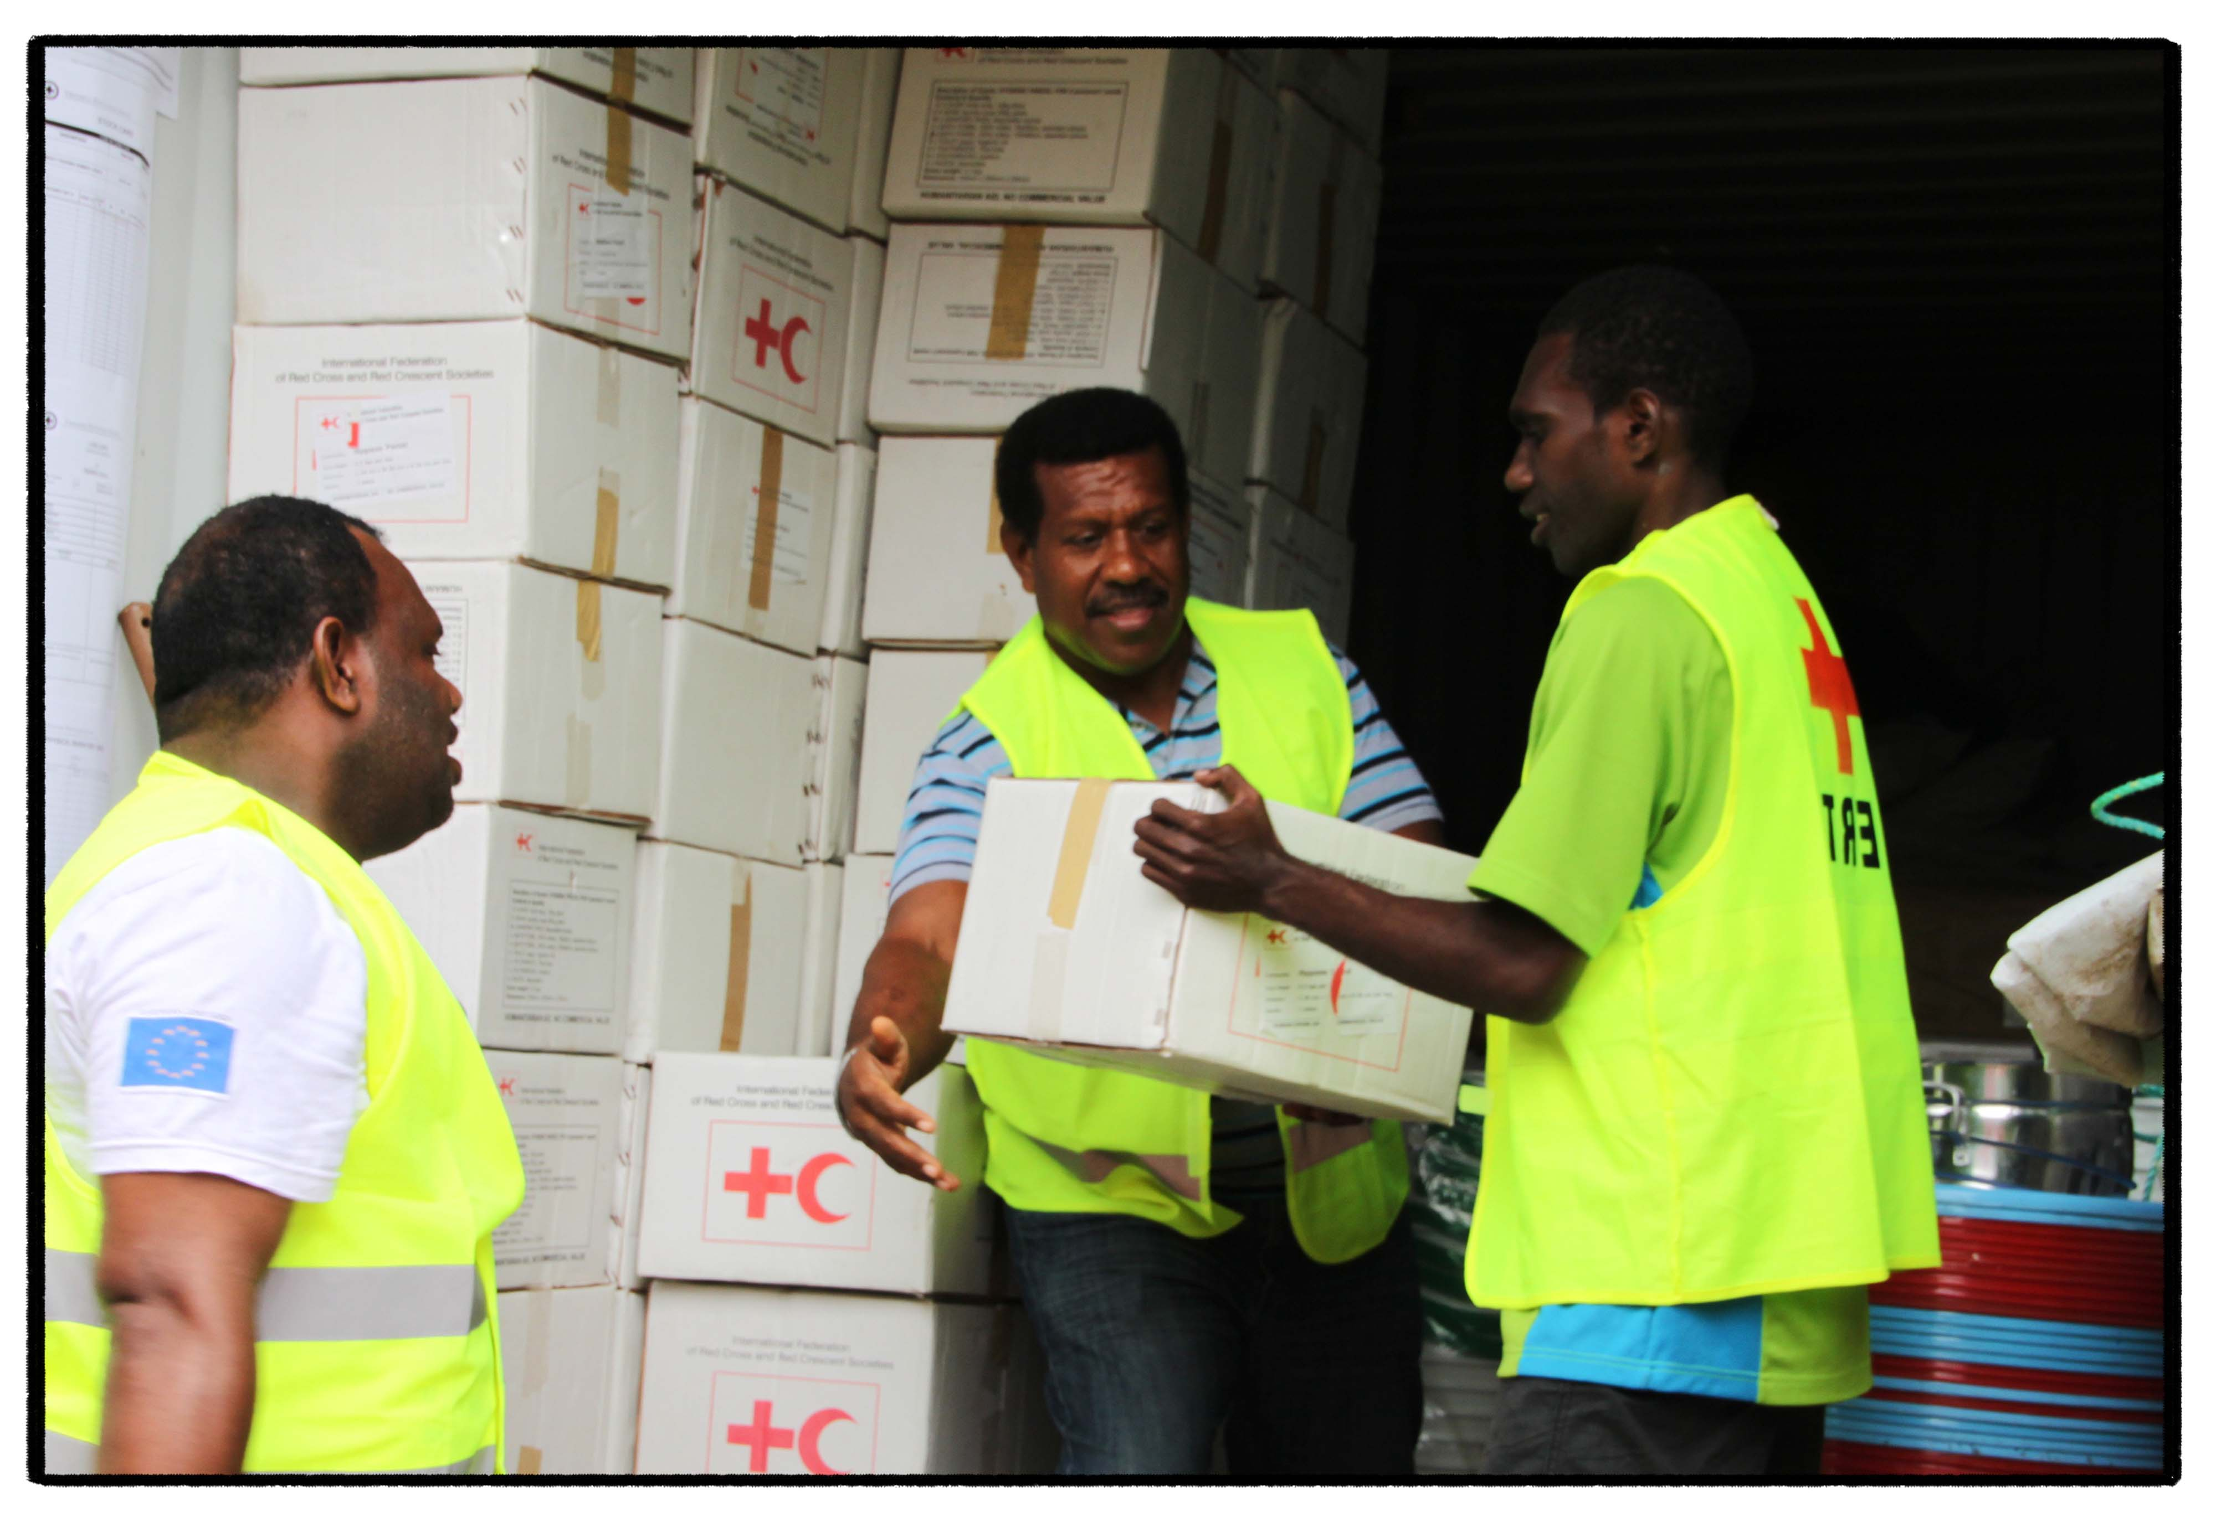
Notes:
Vanuatu Red Cross i gat five (5) bigfala container we i oli stap usum long ol bigfala ship mo two haos blong storem ol samting long hem long Vanuatu. Ol container wetem tufala haos ia oli storem wetem ol samting we ol man i nidim after long wan disasta olsem tapolen, rop, ol contena blong wota, ol shovel wetem ol samting blong cook long hem. Evri tri manis, ol ofisa blong Vanuatu Red Cross oli mekem wan stock take long evri samting ia mo mekem sua se i gat enaf sapplae i stap redi blong usum afta long wan disasta. I gat wan stock take tu long evri Red Cross society long Pasifik includum yumi long Vanuatu bifo long saeklon sisen hemi start long Novemba evri yia. Oli monitorem gud ol fokast blong ol tropikol depression long Novemba kasem logn Aprel evri yia.

Slide 22
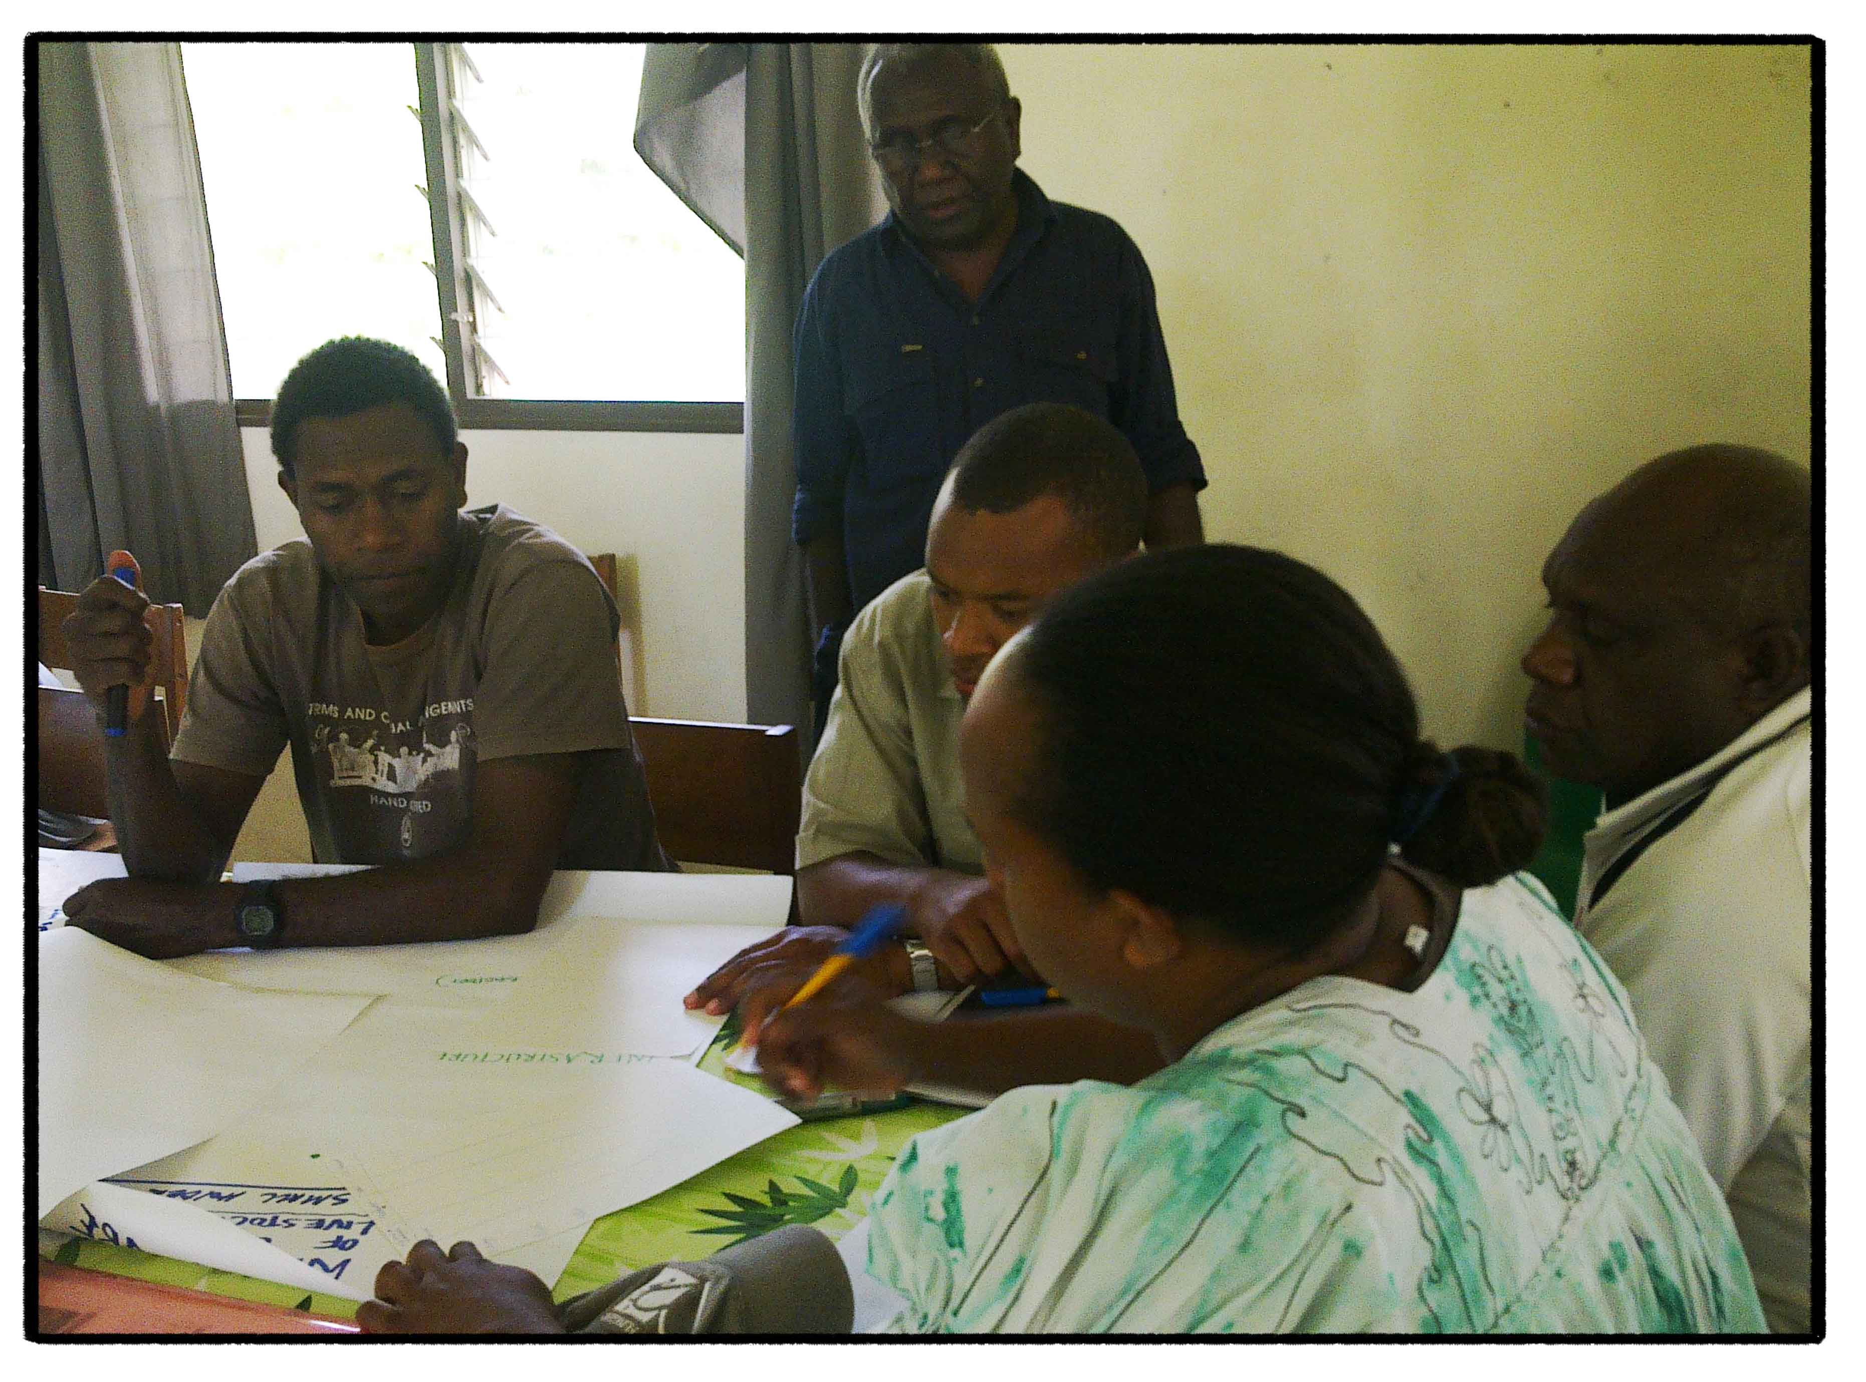
Notes:
Dipatment blong akricalja wetem livestock oli stap wok wetem dipatmen blong Vanuatu Meteorology mo Geo-hazard blong tekem earli aksen. Ol pikja ia i some ol ofisa blong tufala dipatment ia oli tokbaot klaemet wetem ol weta scenarios (olsem wan El Niño event ) mo kamap wetem some aksem plan blong prepea from ol event ia.

